Slide 1
Navgan shikshan sanstha Rajuri’s (N)
MRS KESHARBAI SONAJIRAO KSHIRSAGR ALIAS KAKU
Arts, Science And Commerce College, Beed.
ISO 9001-2008 Certified & NAAC accredited Grade

Slide 2
Department of urdu
PowerPoint presentation by:
Dr.Syeda Shahezan Parveen

Slide 3
For
B.a second year

Slide 4
اردو قواعد

Slide 5
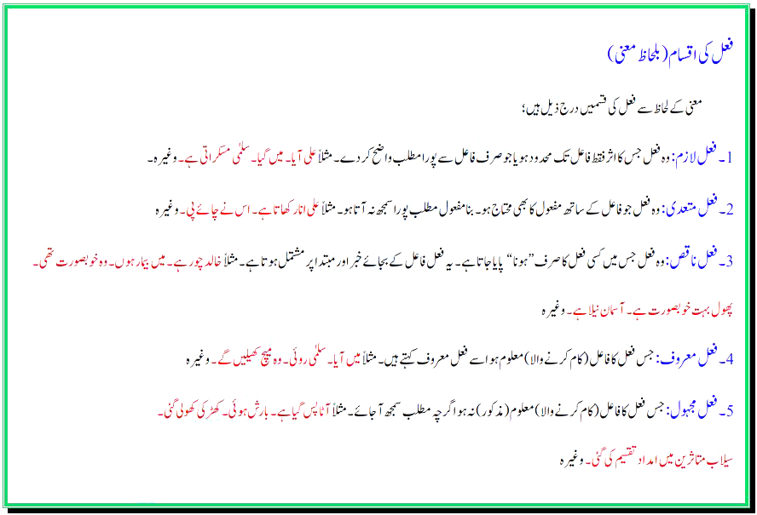

Slide 6
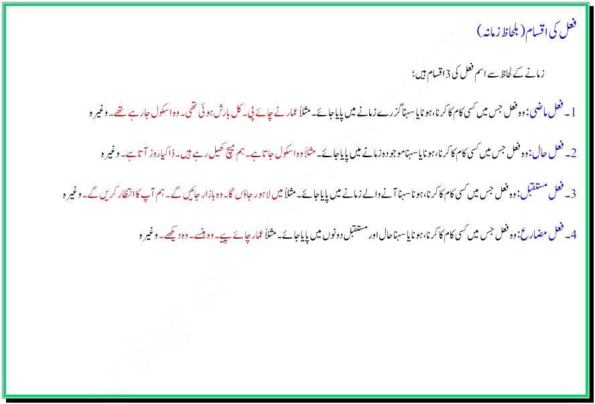

Slide 7
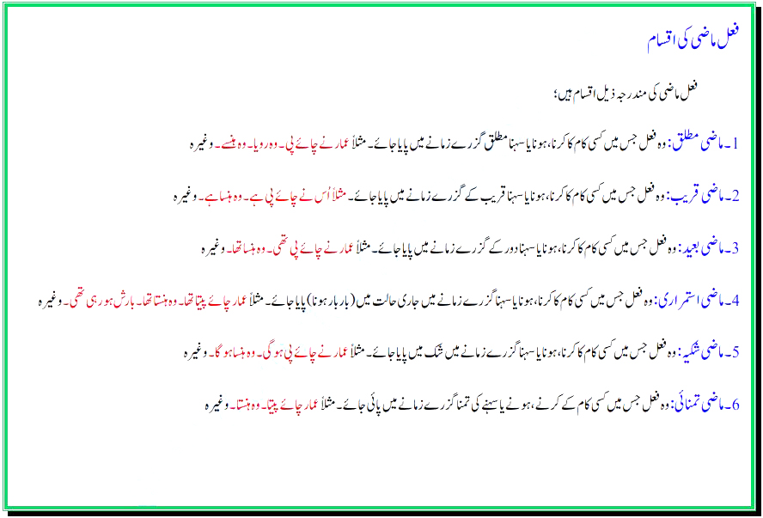

Slide 8
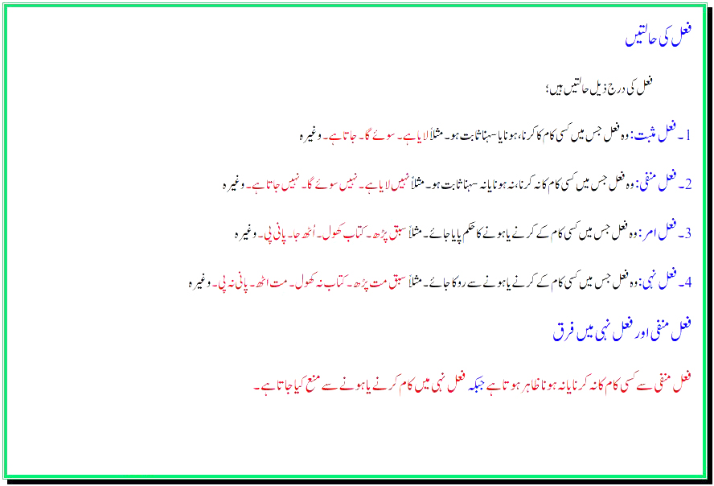

Slide 9
ختم شدہ

