Slide 1
Navgan Shikshan Sanstha Rajuri (N).
Mrs.Kesharbai Sonajirao Kshirsagar Alias Kaku
Arts, Science & Commerce College
BEED
ISO 9001-2008 Certified
[Affiliated to: Dr.Babasaheb Ambedkar Marathwada University, Aurangabad]

Slide 2
Department of Physics

Slide 3
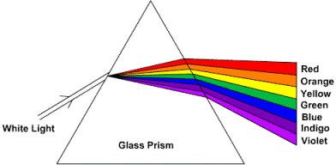
DEPARTMENT OF PHYSICS

Slide 4
DEPARTMENTAL PROFILE 1. Introduction of department 2. Establishment of the department 3. Former heads / Teaching / Non Teaching Staff list 4. Faculties Available 5. Achievement of Faculty 6. Best Practices 7. Books available 8. Students Profile 9. Results 10. List of Alumni 11. Future plan.

Slide 5
Introduction of Department
The college is established in June 1971 with Arts and Commerce faculty. The Science faculty has been started in June 1972. Prof. S. D. Chidgopkar joined this college in June 1972. The Physics Department at present has two senior college teachers. The department was first established in a Laboratory of area 20 Sq. meter. With a laboratory equipments of Rs. 18000/-. At present Physics Department has 120 Sq.mtr. areas in two laboratories. Forty students can work in the laboratories at a time. For weaker students remedial classes are arranged. Also seminars are arranged among students and discussions are carried out on difficult topic. The laboratory is well equipped with instruments. The yearly budget allotted to Physics Department is approximately of Rs. 50000/-.

Slide 6
Establishment of the department
Year of Establishment : June 1972
Department of Physics was established on
15th June 1972 with two classes.
1) P.U.C. (Pre University Course)
2) B.Sc. Ist Year.

Slide 7
LAB AREA SIZE, STUDENTS CAPACITY OF LAB
LABORATORY I :
SIZE : 7.84 MTR. X 7.3 MTR.
THERE ARE SIX TABLES IN THIS LABORATORY. TWENTY STUDENTS CAN WORK IN THIS LABORATORY AT A TIME.
LABORATORY II :
SIZE : 7.10 MTR. X 6.41 MTR.
THERE ARE SIX TABLES IN THIS LABORATORY. TWENTY STUDENTS CAN WORK IN THIS LABORATORY AT A TIME.
LABORATORY III (DARK ROOM) :
SIZE : 4.51 MTR. X 3.3 MTR.
THERE ARE TWO TABLES IN THIS LABORATORY. FIVE STUDENTS CAN WORK IN THIS LABORATORY AT A TIME.

Slide 8
FORMER HEADS / TEACHERS /NON TEACHING STAFF
NAME OF FORMER HEADS :
1) PROF. S. D. CHIDGOPKAR ( 1972 to 2006 )
2) PROF. S. G. KENDRE (2006 to 2011)
NAME OF FORMER TEACHERS ON C.H.B.:
1) PROF. DONGARE ASHOK KALYAN (1999 to 2003)
2) PROF. GHOLAP NARAYAN ASHRUBA ( 2006 to 2011)
NAME OF FORMER NON TEACHING STAFF:
1) Shri. Choure B. C. (Lab. Attendent)

Slide 9
FACULTIES AVAILABLE
TEACHING STAFF:
1)Dr. KSHIRSAGAR S.V. (H.O.D. & ASSISTANT PROFESSOR)
2)Dr. Mrs. MAHESHMALKAR P.R. (ASSISTANT PROFESSOR)
NON TEACHING STAFF:
1)SHRI. GANGE A.H. (LAB. ATTENDENT)
2)SHRI. DARADE V.S. (LAB. ATTENDENT)

Slide 10
Achievement of Faculty
Dr. Kshirsagar S.V. awarded Ph.D degree in Nov 2009 From Dr. B.A.M.U, Aurangabad.
Dr. Maheshmalkar P.R. awarded Ph.D degree in Nov 2010 from Dr. B.A.M.U, Aurangabad.
Dr. Kshirsagar S.V.elected as a member of Board of Studies in physics at Dr. B.A.M.U, Aurangabad in Feb. 2011.
Dr.Kshirsagar S.V. submitted Minor Research Project to UGC(WRO) PUNE Entitled “Effect of temperature on some spinel ferrites prepared by ceramic method”.
Research Papers Presented :
Dr.Kshirsagar S.V. 03
Dr. Maheshmalkar P.R 03
PARTICIPATION IN SEMINARS, WORKSHOP, CONFERENCE: Dr. Kshirsagar S.V. 09
Dr. Mrs. Maheshmalkar P.R 04

Slide 11
EDUCATIONAL TOURS/VISITS
1) Our students with faculties were organized study tours & visited JAI BHAVANI SUGAR FACTORY, GADHI TQ. GEORAI, DIST. BEED. Student collected information about working of Polariometer .
2) Our students with faculties were organized study tours & visited WIND ENERGY PROJECT AT SAUTADA TQ. PATODA , DIST. BEED on date 12th aug., 2011. They get knowledge about Production of Wind Energy and its importance in future.

Slide 12
Best Practices
Department run remedial coaching for
slow learners.
Department organize Student Seminars,
Group Discussion.
Department organize Educational Tours.
Department Publishes Wall Papers & Booklets frequently.
Use of OHP, LCD Projector for Teaching.
Departmental Library available for Students.

Slide 13
Books / Journals Available
Main Library
Books:- 1317
Journals:- 07
Departmental Library
Books:- 72

Slide 14
LIST OF JOURNALS AVAILABLE IN MAIN LIBRARY
Indian journal of Biochemistry &Biophysics
Pramana
Science Reporter
Bulletin of material Science
Physics for You
Current Science
Journals of Physics

Slide 15
Gender wise Student Strength
Year | Class | Male | Female | Total
2006-07 | B.Sc. I B.Sc. II B.Sc. III | 36 17 27 | 25 13 12 | 61 30 39
2007-08 | B.Sc. I B.Sc. II B.Sc. III | 48 18 12 | 16 24 09 | 64 42 21
2008-09 | B.Sc. I B.Sc. II B.Sc. III | 42 27 17 | 12 11 17 | 54 38 34

Slide 16
2009-10 | B.Sc. I B.Sc. II B.Sc. III | 50 14 13 | 16 06 13 | 66 20 26
2010-11 | B.Sc. I B.Sc. II B.Sc. III | 49 39 13 | 20 16 08 | 69 55 21
2011- 12 | B.Sc. I B.Sc. II B.Sc. III | 38 15 37 | 13 29 13 | 51 44 50

Slide 18
Year | Class | Results
2006-07 | B.Sc. I B.Sc. II B.Sc. III | 75.00% 85.00% 89.28%
2007-08 | B.Sc. I B.Sc. II B.Sc. III | 78.00% 81.00% 83.00%
2008-09 | B.Sc. I B.Sc. II B.Sc. III | 60.00% 62.50% 65.30%
2009-10 | B.Sc. I B.Sc. II B.Sc. III | 93.80% 74.50% 75.00%
2010-11 | B.Sc. I B.Sc. II B.Sc. III | 94.44% 92.59% 94.59%
RESULT ANALYSIS – LAST 5 YEARS

Slide 20
List of prominent Alumni with present position
Sr.. Name of Alumni Year of Passing Designation Venue
No.
1. Shri. Nagargoje Sanjay Ramrao 2003-04 S.T.O. Aurangabad
2. Shri. Tekade Sanjay 2004-05 S.T.O. Bombay
3. Shri. Kashid Ram Pandurang 2004-05 Adv. District
Court, Beed.
4. Shri. Karad Shivraj Haribhau 2007-08 Trafic Georai
Inspector
5. Shri. Naiknavre Yogesh Prakash 2007-08 Police P.S. Beed
6. Shri. Puttewad Sachin Namdev 2007-08 Clerk MSRTC
Beed Depo
7. Shri. Ankushe Vijay 2007-08 Clerk Collector
Office Beed.
8. Shri. Pawar Pramod 2006-07 Jr. Lect. Wangi
Tq.Dist. Beed

Slide 21
List of prominent Alumni with present position
Sr. Name of Alumni Year of Passing Designation Venue
No.
9. Shri. Raut S. R. 1999-2000 Assi. Prof. Mrs. K.S.K.
College, Beed
10. Shri. Ghodke Ganesh 1999-2000 H.M. Borgaon High
School, Borgaon
11. Shri. Gaikwad V. K. 1997-98 Jr. Lecturer Mrs.K.S.K.
College, Beed
12. Shri. Ajabe Bharat 2004-05 Assi. Prof. Aditya Engg.
College, Beed
Dr.Hussaini S.S 1989-90 H.O.D& Millya Assit.Prof College,Beed
14 Ms. Shaikh S.R 2003 -06 Jr. Lecturer Mrs.K.S.K.
College, Beed

Slide 22
FUTURE PLAN
Year | Activity | Tentative Month
2011 – 12 | School college interaction | July 2011
 | A Visit to Wind Energy Project | Aug. 2011
 | Proposed to submit minor research project of Faculty | Oct. 2011
 | To organize State level Seminar on recent trends in Physics. | Jan. 2012
2012 -13 | A Visit to Solar Energy plant | Aug. 2012
 | Recommendation to submit the proposal to start P.G. course | Jan.2013
 | To submit the proposal for reorganization of laboratory for research centre. | Feb.2013

Slide 23
2013 - 14 | To organize state level Conference on Nanotechnology | Aug. 2013
 | To Submit the proposal for Research Guide of Faculty | Oct.2013
 | A Visit to I.U.C.A.A. Pune (Educational Tour) | Jan. 2014
2014 -15 | A Visit to Satellite centre at,Jalna (Educational Tour) | July.2014
 | School college interaction. | Oct. 2014
 | To submit the proposal to start Certificate courses | Jan. 2015
2015-16 | A Visit to Parli Thermal Station, Parli (Educational Tour) | Aug. 2015
 | To organize university level workshop on experiments in physics for B.Sc.I, II, III. | Dec. 2015
 | To Submit the proposal for Major Research Project of Faculty | Jan. 2016

Slide 24
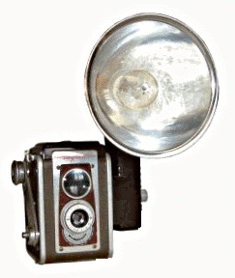
Pictography
Departmental

Slide 25
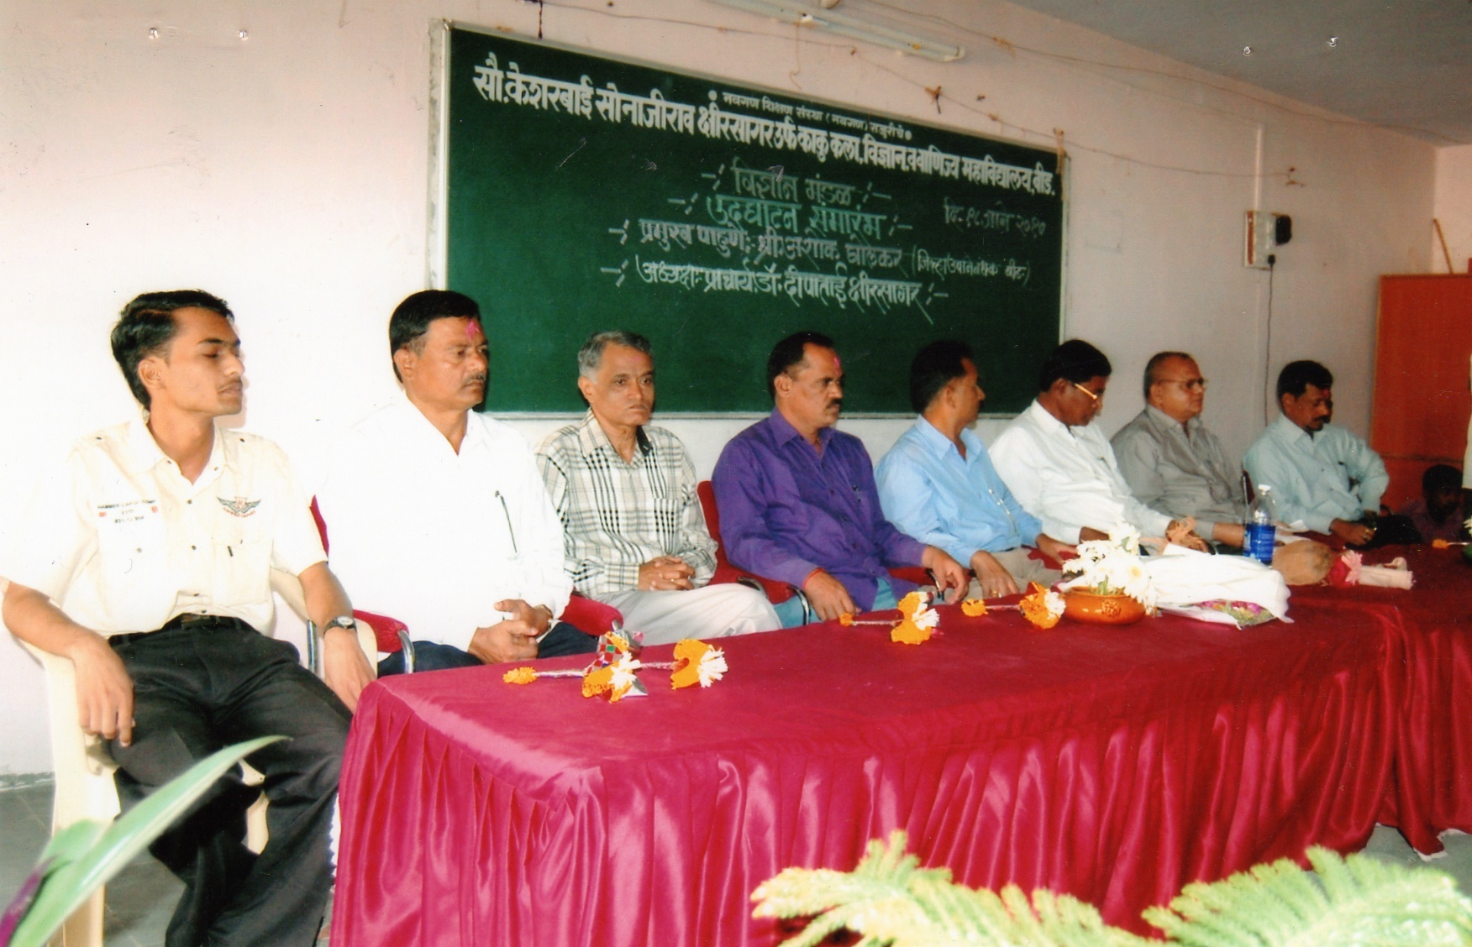

Slide 26
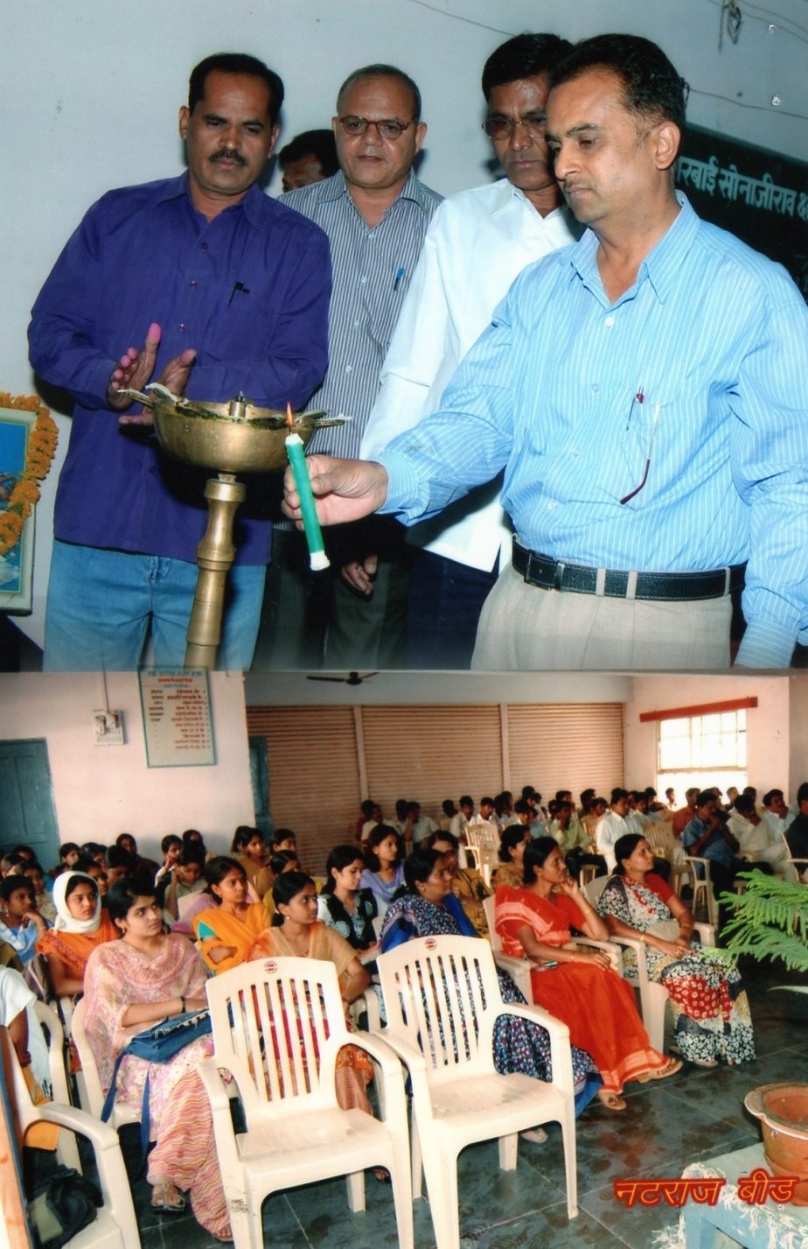

Slide 27
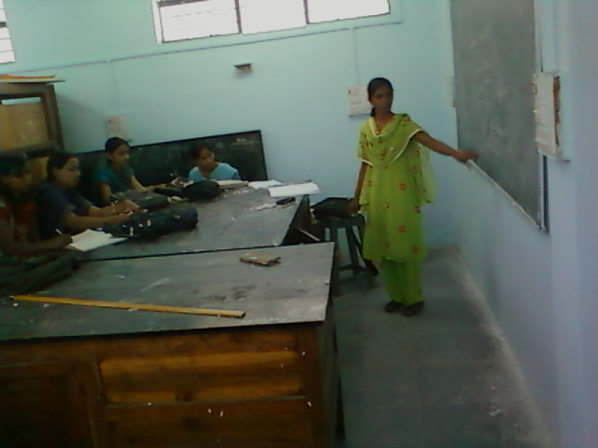

Slide 28
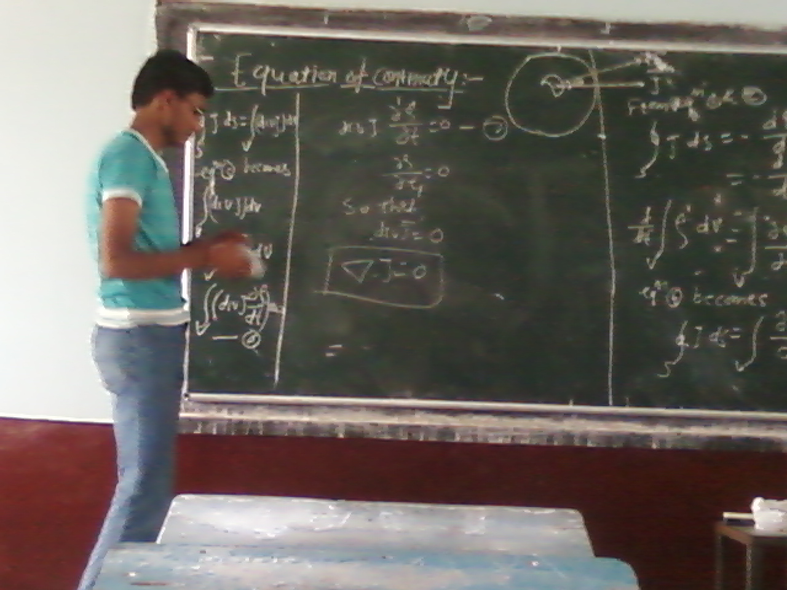

Slide 29
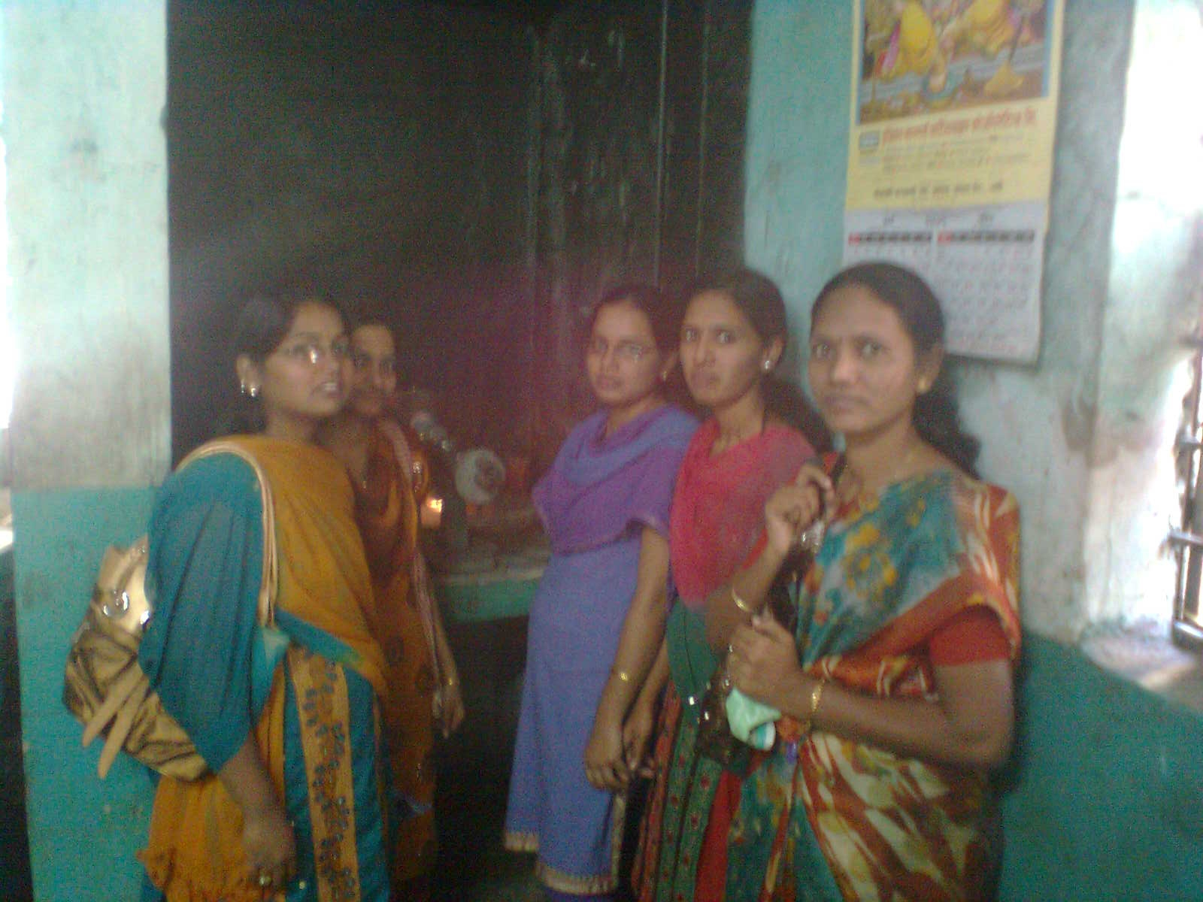

Slide 30
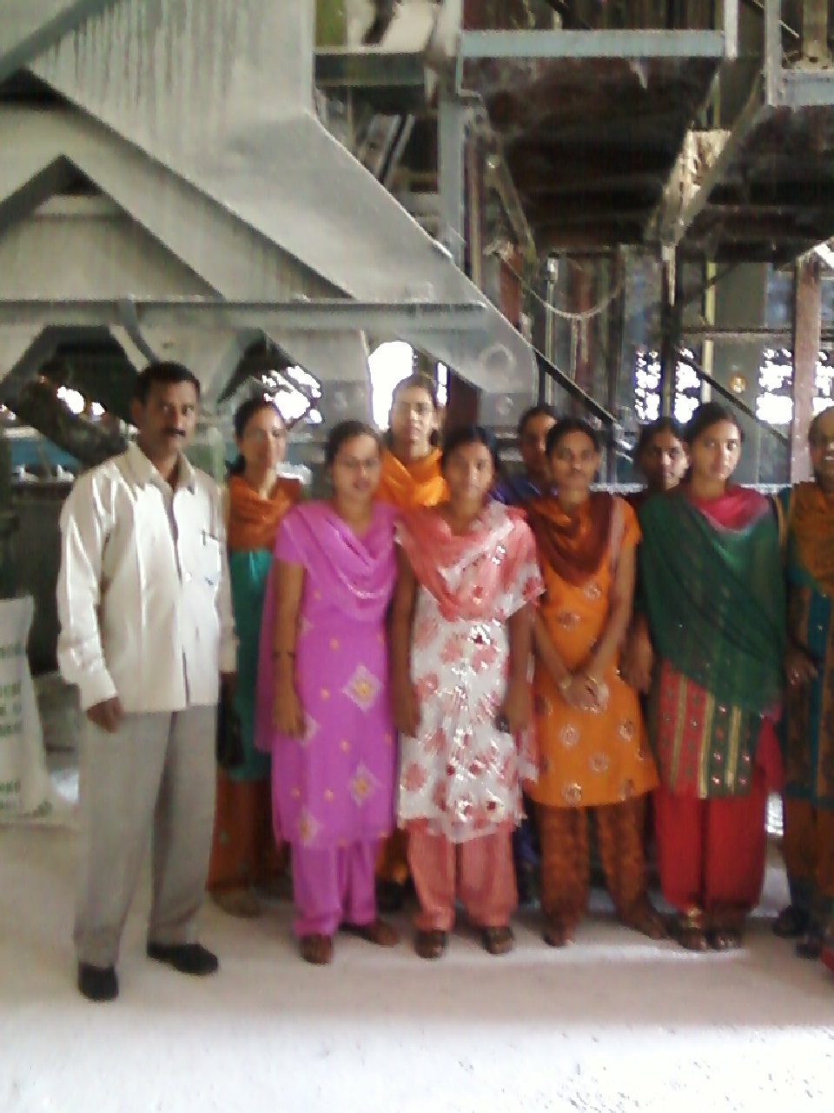

Slide 31
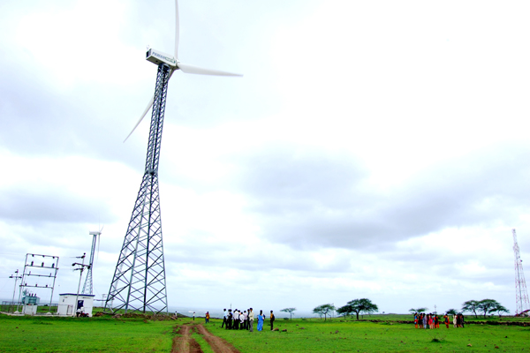

Slide 32
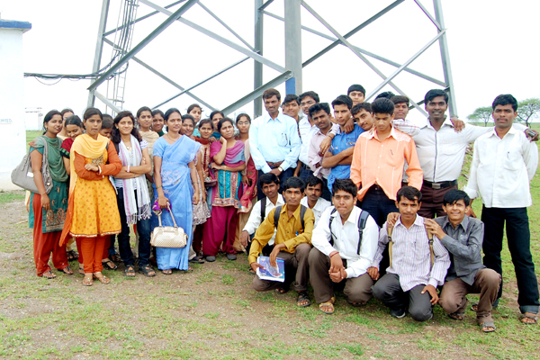

Slide 33
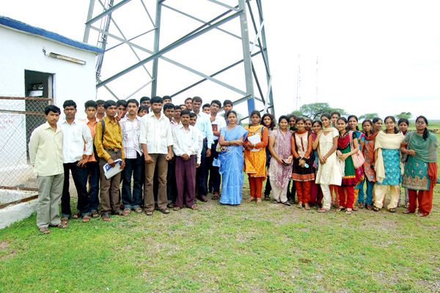

Slide 35
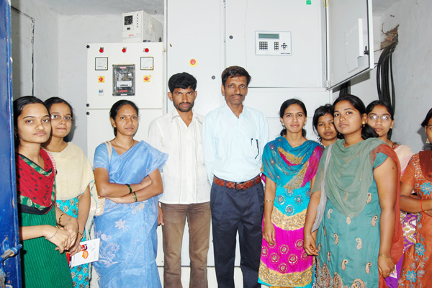

Slide 36
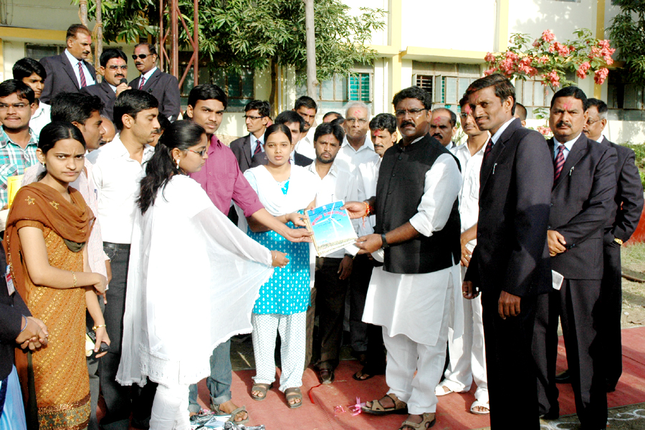

Slide 37
