Slide 1
Mr. Shaikh Amjad R. Asst. Prof in Dept. of Computer Sci. Mrs. K.S.K College Beed
Computer Networking

Slide 2
Introduction Of Computer Network.
A collection of individual computers interconnected by a single technology is known as “Computer Network”.
Computers are connected together to share the resources like hardware, software and data.
A network is a group various components connected together in such a way that it is possible to share a component, distribute the information among the entire group.
Two computers are said to be interconnected if they are able to exchange information.
The computers are interconnected by use of transmission media such as fiber optics, microwave infrared(IR), and communication satellites.
Networks satify a broad range of purposes and meet different requirement some of the common objectives of computer communication networks are:
1) To provide sharing a geographically distance resources that is information or databases or processors.
2) To provide communication among users. Network users geographically for apart from each other can converse in an interactive session or send messages to each other.
3) To increase the reliability of processing capacity through back up and redudancy if one processing unit breaks down, another physical distant processors can take over.
4) To provide distributed processing capabilities that means taking the processing out of a single large computer and distributing it to the place where the data is generated.

Slide 3
Application Of Computer Network.
Business Application- Business application have different application have different types are-
Resources Sharing – the goal is to make all programs, equipments, and especially data available to anyone on the network.
Setting up computer – Network has to do with people rather than information. Ex-Email.
E-commerce- Airlines, bookstores,reservation, bill.
(2)Home application includes-
(1)Access to remote information.
(2)Peer-to-peer communication.i.e.Chatting.
(3)Interactive Entertainment.
(3)Mobile users – This application is one of the fastest growing segments of the computers.PDAs.

Slide 4
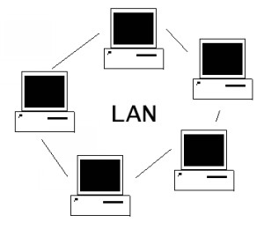
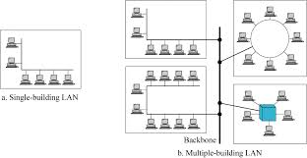
Types of Network.
LAN.
MAN
WAN.
(1)LAN
A LAN is privately owned and connection the device in a office, building,or campus.
LAN are designed to allow resources to be shared between personal computers.
The resources to be shared can hardware, software or data.
A LAN is a network that is a specific confined to relatively small area or a single building.
LAN enable you to connect a group of computer.
A Lan is so called, because the network is confined to a specific area which is called the “Local Area”.
The LANs have three types of characteristics that are:
1)size-LANs are restricted in size that is specific range.
2)Transmission Technology-LANs can use a transmission technology consisting of cables to which all machines are connected.
3)Network topology-LANs can use of bus topology, ring topology, or star topology.
The speed of LANs depending on topologies. The speed LAN 4-16mbps to 10gpbs if bus topology is used. The today speed of LAN is 10gpbs.

Slide 5
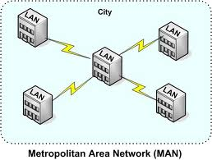
[2]MAN –
MAN means metropolitan area network.
A MAN is designed to extend over an entire city.
A MAN may be entirely owned and operated by private or operated by public i.e. telephone company.
Many telephone companies provide a popular MAN service called switched multimegabit data service.
Figure-MAN.

Slide 6
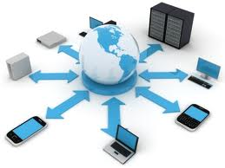
[3].WAN –
WAN means wide are network.
Wan spans a large geographic area, such as a state, providence or country.
WANs often connect multiple smaller networks, such as local area networks or metro politan area network.
WANs are used to connect server machines and computer across continents are countries for constant information updates.
WAN are used across the globe many network connect with one another across continent to create one giant wide area network.
It provides long-distance transmission of data over large geographic area that may comprise a country a continent or even the whole world.
The machines which makes this network is called as hosts.
WAN is subdivided into subnets consists of two elements that are:
(1) Transmission Lines –
It is used to carry the information between the hosts.
(2) Switching Elements –
The switching elements will connect different subnets and device is known as “router”.
Fig.Wide Area Network.

Slide 7
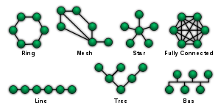
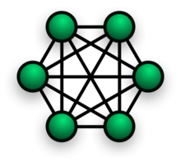
Network Topology-
The physical topology of a network to the configuration of cables, computers and other peripherals.
Physical topology is the method that used to pass information between workstations.
These are four different types of topologies that are-
Linear Bus Topology –
Star Topology –
Star-wired Ring Topology –
Linear Bus Topology-

Slide 8
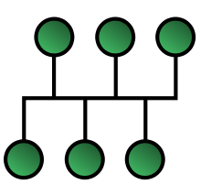
Linear Bus Topology –
A linear bus topology consists of a main run of cable with a terminator at each end.
All nodes are connected to the linear cable.
Ethernet and local talks use a linear bus topology.
Nodes are server, workstations and peripherals.
Nodes are connected to the bus cable by drop lines and taps.
The drop line is a connection running between the device and the main cable .
A tap is connector that either spaces into the main cable.
Advantages:
2)Require less cable length than a star topology
1)Easy to connect a computer or peripheral to a linear bus..
Disadvantages:
1)Entire network shuts down if there is a break in the main cable.
2)Terminators are required at both ends of the backbone cable.
3)Difficult to identify the problem if the entire networks shuts down.
4)Not meant to be used as a stand alone solution in a large building.
Figure-Linear Bus Topology

Slide 9
(2)Star Topology –
A star topology is designed with each node(server, workstation, and peripherals)connected directly to a central network hub.The device are not directly linked to one another.
The hub acts as an exchange the hub is called as central controller.If one device wants to send data to another it sends the data to the hub, which then relays the data to the other connected device.The hub manages and controls all functions of the network it also acts as a repeater for the data flow.Hub is refered as concentrators.
Advantages:
1)Easy to install and reconfigure.
2)It is less expensive than a mesh topology.
3)No distruptions to the network then connecting or removing devices.
4)Easy to detect faults and to remove parts.
Disadvantages:
1)Require more cable length than linear topology.
2)If the hub fails, nodes attached are disables.
3)More expensive than linear bus topologies because of the cost of the hub.

Slide 10
(3) Star –Wired Ring Topology –
A Ring topology can appears externally to be similar a star topology but internally.
Multistation access unit (MAU) of a ring topology containswiring that allows information to pass from one device to another in a ring it is also known as star-wired ring.topology.
In a ring topology, each device has a point to point connection only with the two devices an either side of it.
A signal is passed along the ring in one direction from device to device, untill it reaches its destination.
Each device in this topology incorporates a repeater.
Advantages:
1)It is easy to install and reconfigure.
2)Each device is connected to its neighbours.
3)To add or delete a device requirements changing only two connection.
4)Easy to detect faults and to remove the parts.
5)It can issue an alarm if one device does not receive a signal a specific period.
Disadvantages:
1)It is a unidirectional.
2)Entire network shuts down if there is break in the main cable.

Slide 11
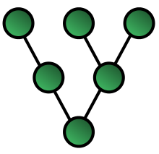
(4) Tree Topology –
A tree topology combines characteristics of linear bus and star topology.
It consists of group of star configured workstations connected to a linear bus backbones cable.Tree topology allow for the expansion of an existing network.
Advantages:
1)Point to point wiring for individual segments.
2)Supported by several hardware and software.
3)Use of mesh topology to links , guarantees each connection can carry its own data lo
ad, therrefore eliminating the traffic problems that can occure when links must be
shared by multiple devices.
4)Robust-If one connection becomes unusable, of does not incapacitate the entire sysyem.
5)Security-when every messages travel along a dedicated line, only the intended
receipent sees it
6)It makes fault identification and fault isolation easy.
Disadvantages:
1)More difficult to configure and wire than other topologies.
2)Installation an reconnection are difficult, because every devise should be connected to every other device.
3)If the backbone line breaks, the entire segment goes down.
4)The network required to connect each link that is input output ports and cable can be prohibitively expensive.
Figure-Tree Topology.

Slide 12
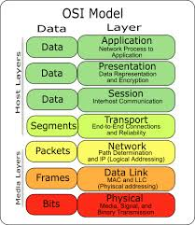
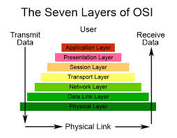
The Seven Layer Of The OSI Reference Model
Layer 7 - Application Layer.
Layer 6 - Presentation Layer.
Layer 5 - Session Layer.
Layer 4 - Transport Layer.
Layer 3 - Network Layer.
Layer 2 - Datalink Layer.
Layer 1 - Physical Layer.

Slide 13
(1)Application Layer :- (Layer 7)
The Application layer is the top layer of the OSI model. Application layer is the higher layer in the TCP/IP model. The application is located at layer4.
The application layer serves as the window for users & application processes to access network services. This layer contains a variety of commonly needed function.
1)Resource sharing & device redirection.
2)Remote file access.
3)Network management.
4)Remote printer access.
5)Directory services.
6)Electronic messaging(such as email.)
7)Network virtual terminals.
It is used by applications to access across a TCP/IP network.
At this layer application are operated such as-web browser, file transfer program, remote login program.
The application layer passes data to the next layer that is transport layer.
An application layer is placed an layer 7. It handles general network access, flow control, and error or recovery some of the functions it supports.
FUNCTIONS:-
Accessing remote file.
Accessing remote printers.
Accessing remote database.
Electronic mail.

Slide 14
(2)Presentation layer:-(Layer 6)
The presentation layer is located at layer 6. It takes the data provided by the application layer and converts it into a standard format that the other layers can understand.
It is the translator for the network as it determines the format used to exchange data among the computers on the network.
FUNCTION:-
Protocol conversion.
Data translation.
Data encryption.
Data compression.
Conversion of the character set.
(3)Session Layer:-(Layer5)
Session layer establishes, maintains and ends communication with the receiving device.
The session layer allows session establishment between processes running on different stations. It provides:
1)Session establishment maintaince & termination:allows two application
processes on different machines to establish, use and terminate a
connection, called a session.
2)Session Support:Performs the function that allow these processes to communicate over the network, performing security, name recognition, logging and so on.

Slide 15
(4)Transport Layer:-(Layer 4)
Transport Layer is responsible for ensuring that all the data is delivered in correct sequence, error free with no losses.
It is the transport layer that breaks up large messages into smaller packets for delivery.Some of the other functions provided by the transport layer are.
FUNCTION:
Error handling.
Flow control.
(5)Network Layer:-(Layer 3)
The network layer control the operation of the subnet, deciding which physical path the data should take based on network conditions, priority of service and other factors.
It is responsible for determining the that is taken from the transmission computer to the receiving computer. It is also responsible for addressing messages and translation of logical across a TCP/IP network.
(6)Data Link Layer:-(Layer 2)
The data link layer is responsible for providing error free transfer of frames from one computer to another using the physical layer.A frame is a bundle of information sent as a single entity.
Some of the other functions provided by the data link layer are:
Function:
1)Transmitting and receiving frames sequentially.
2)Providing frames acknowledgement for frames it receives.
3)Retransmitting frames that are not acknowledged by the receiving computer.

Slide 16
(7)Physical Layer:-(Layer 1)
The physical layer, the lowest layer of the OSI model, is concerned with the transmission & reception of the unstructured raw bit stream over a physical medium. It describes electrical, mechanical, and functional interfaces to the physical medium & carries the signals for all of the higher layers. It provides:
1)Data encoding:modifies the simple digital signal pattern(1s & 0s) used by the PC to better accommodate the characteristics of the physical medium, and to aid in bit & frames synchronization. It determines:
What signal state represents a binary 1.
The physical layer has complex tasks to perform the physical layer task is to provide service for the data link layer.
The data in the data link layer consists of 0s and 1s organized into frames that ready to sent through the transmission medium.
This stream of 0s and 1s should first be converted into another entity that is signals one of the services provided by physical layer is to create signal.
The physical layer is consist of several components and its represented.
Components of physical layer:
1)Services.
2)Bit signal transformation.
3)Bit-Rate control.
4)Bit-synchronization.
5)Multiplexing.
6)Circuit switching.
7)Transmission media.
8)Telephone network.
9)High speed access.

Slide 17
END

