Slide 1
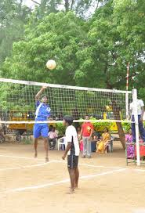
WEL COME to
Dr. Uhave Kale
Department of Physical Education

Slide 2
The Sports education model

Slide 3
Key components
Physical Education/Sports Education
Intramural Sports
Interscholastic Athletics

Slide 4
Seven Characteristics of Sport Education
Sports education involves seasons rather than units
Students quickly become members of teams
The schedule for competition is formal
There is a major accumulating event
The sport is recognized and the stats are recorded
Entertainment is included to provide excitement, meaning and social interaction.
Students become involved.

Slide 5
Teacher Role
Student-centered instruction.
The teacher is present to guide the students.
Teacher must establish strong rules and routines before beginning the sport/activity.
Instructs, facilitates, and assesses student learning.
Model works especially well in a team-teaching scenario
Grading…

Slide 6
Student Roles
Responsible for leadership, instruction and performing.
All students practice and play Sports
Team Captain – Coach
Stats. Keeper – records and post team and individual statistics
Manager – equipment manager & sets up field/court
Referee – Is acquainted with rules and etiquette of the sport/activity being played.
Player – participating member of team.
Scorekeeper – keeps tally of game score as it is played

Slide 7
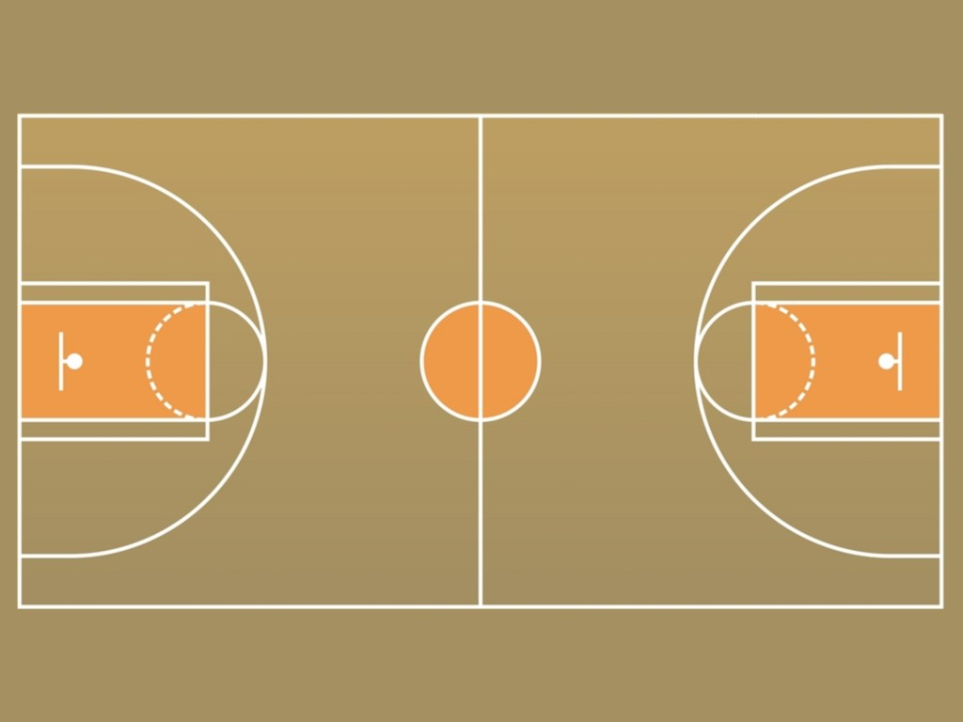
Examples of Activities:
Basketball
Field Hockey
Football
Hockey
Lacrosse
Soccer
Softball
Tennis
Track & Field
Volleyball
Weight Training
Wrestling
Modified Sports…

Slide 8
Creating the Model
Teach students about the roles prior to start of each season.
Talk about student conflicts
Teacher should conduct training sessions for individual jobs students may partake in.
Rules for Referee
Managerial positions
Stats. Keeper
Instructions or teacher authority may vary between grade levels and maturity.

Slide 9
Creating the Model
Make necessary modifications to rules and competition format
Equality – all team members get to play the same amount of time.
Balanced teams: gender, ability, behavior, etc.

Slide 10
END

