Slide 1
Wel Come
Dr.s.v. lamture
Asso. Prof.
Department of Chemistry

Slide 2
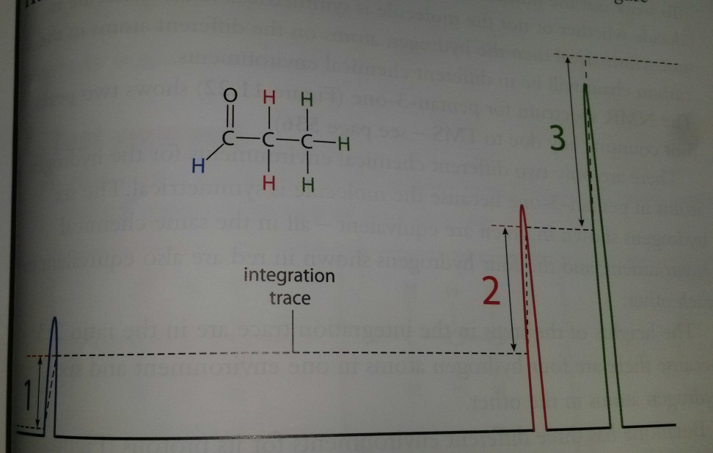
Interpreting L R NMR spectrum
Different sizes of peak give valuable information
Are underneath a peak is proportional to number of hydrogen atoms in that environment.
Area underneath peaks can be worked out by integration trace. The vertical heights of the steps in Integration trace are proportional to the number of hydrogen atoms in each envirnoment.
Three peaks in the spectrum corresponds to different chemical environments of H atoms

Slide 3
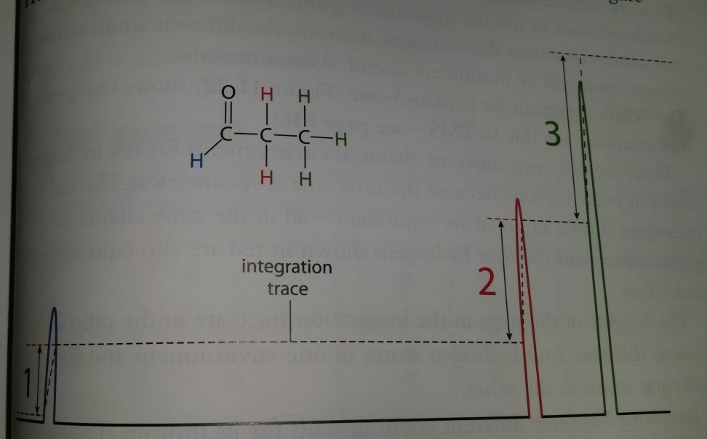
Interpreting L R NMR spectrum
The Chemical Shift gives information about the environment of protons( Hydrogen atoms). The protons in different chemical environment give different chemical shift
Detail about chemical shift will be covered in HL syllabus.
Chemical Shift: The Horizontal scale on NMR, is given by the symbol δ has a unit parts per million ppm.

Slide 4
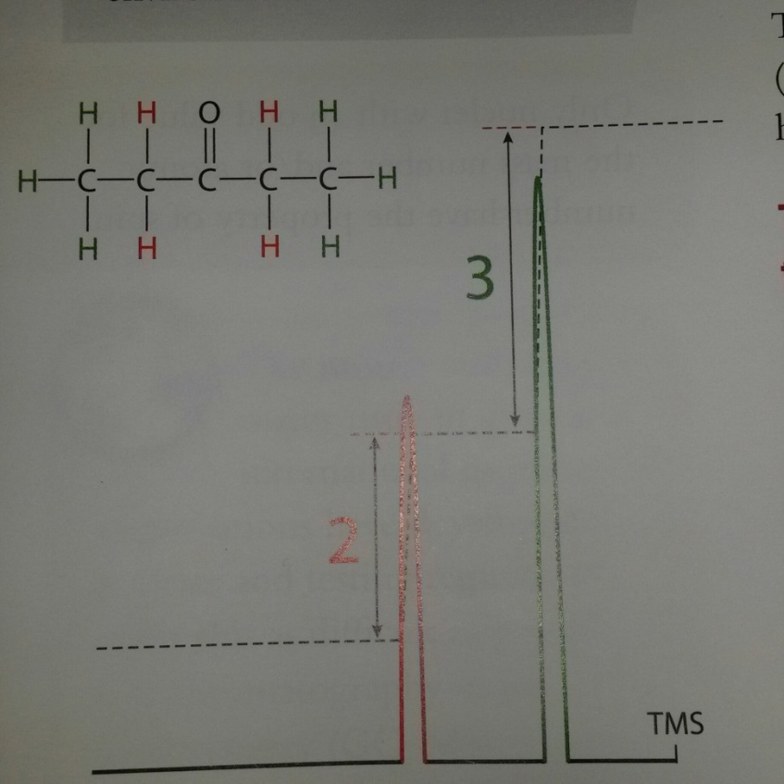
NMR Spectrum of Pentan-3-one
Symmetrical molecule
Two peaks show two different chemical environment
Heights of peaks as ratio of 2;3 in integration trace, show four H atom in one environment and 6 in other.

Slide 5
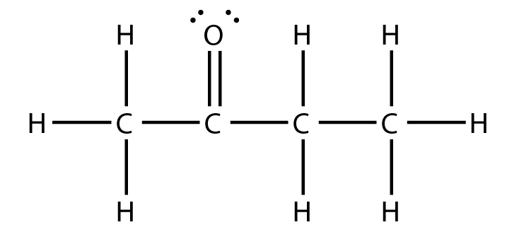
Identify number of different chemical environments and ratio of H atoms in each environment
3
2
3

Slide 6
Chemical Shift ( HL only)
The horizontal scale on a nuclear magnetic resonance spectrum is called chemical shift.
The symbol for chemical shift is δ.
It is measured as parts per million
The Chemical Shift gives information about the environment of protons( Hydrogen atoms). The protons in different chemical environment give different chemical shift
Chemical shift are measured relative to TMS
Chemical shift for TMS is Zero

Slide 7
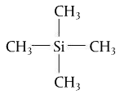
Tetramethylsilane is the standard
All Hs are the same = 1 signal
Si
  Has lower EN than Carbon
  Si absorbs in a different part of the spectrum than C when bonded to H
Si(CH₃)₄
  Has low boiling point
  Is chemically inert (non-reactive)
  Is soluble in most organic solvents

Slide 8
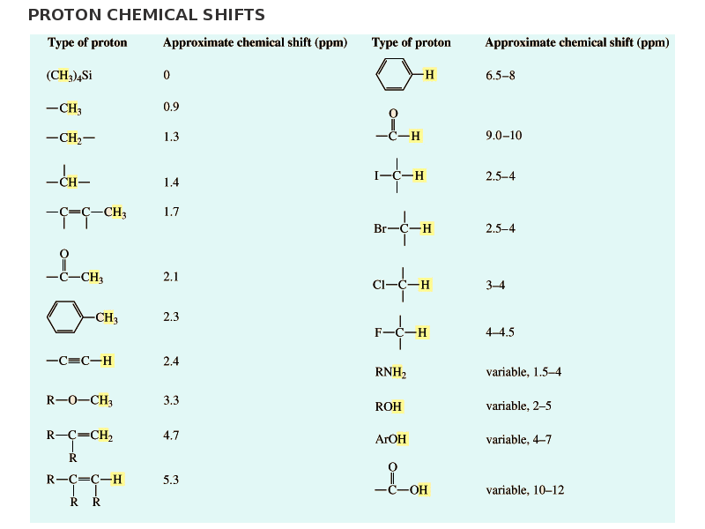
Chemical Shift values relative to TMS
Values are given in data book let page 26, table 27

Slide 9
Thanks

