Slide 1
Wel Come
Dr.S.V. Lamture
Head & Associate Pr.of
Department of Chemistry

Slide 2
Chapters 11 and 12:
IR & NMR Spectroscopy, Identification of Unknowns

Slide 3
IR Spectroscopy
The presence and also the environment of functional groups in organic molecule can be identified by infrared (IR) spectroscopy.
Like nuclear magnetic resonance (NMR) and ultraviolet (UV) spectroscopy, infrared spectroscopy is nondestructive.
Moreover, the small quantity of sample needed, the speed with which spectrum can be obtained, the relatively low cost of the spectrometer, and I wide applicability of the method combine to make infrared spectroscopy one the most useful tools available to the organic chemist

Slide 4
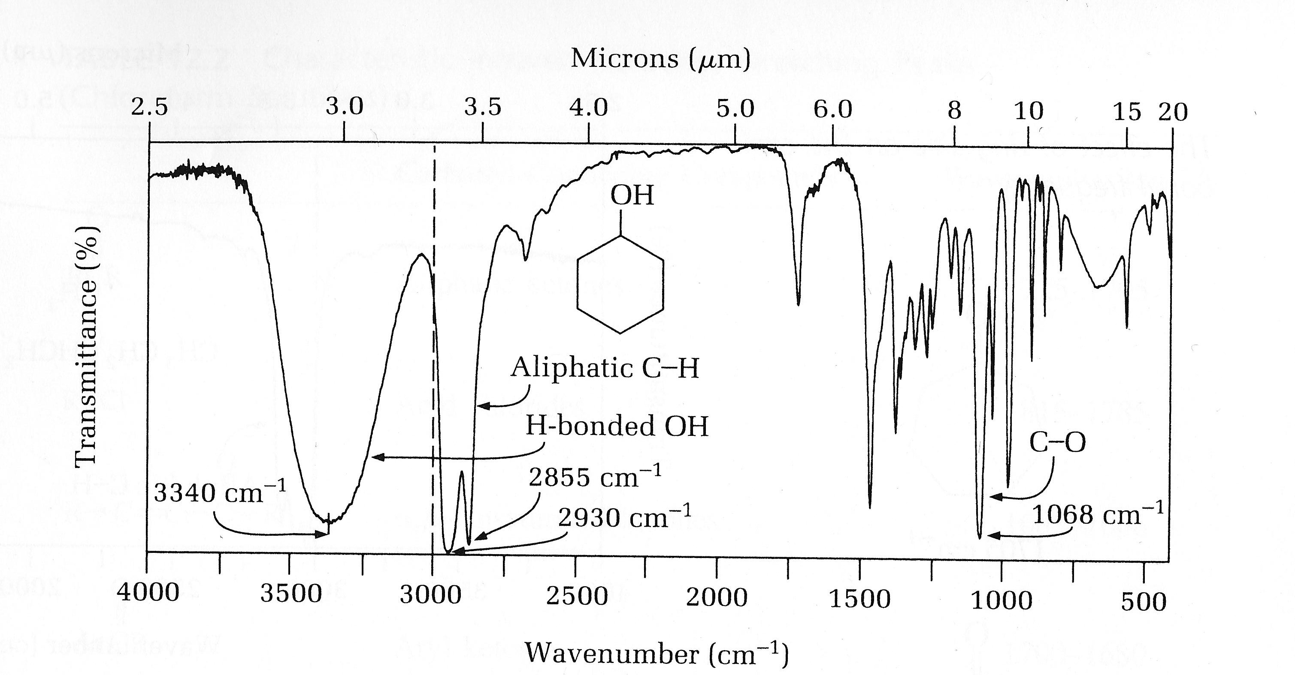
IR Spectum
“Fingerprint” region

Slide 5
IR Spectra Interpretation
Tables 11.1 (p. 233) and 11.2 (pp. 238-239) contain characteristic IR peaks of functional groups

Slide 6
NMR Spectroscopy
Nuclear magnetic resonance (NMR) spectroscopy is a means of determining the number, kind, and relative locations of certain atoms, principally hydrogen and carbon, in molecules.
The number of peaks or groups of coupled peaks indicate the number of chemically and magnetically distinct hydrogen or carbon atoms in a molecule
The integral indicates the relative number of protons within a peak or group of peaks.
The separation within a group of peaks, called the coupling constant, J, can give information about the locations of the protons relative to other nearby protons and thus, the geometry of the molecule.
And the location of a peak in the spectrum is called the chemical shift δ and indicates which kind of proton gave rise to the peak.

Slide 7
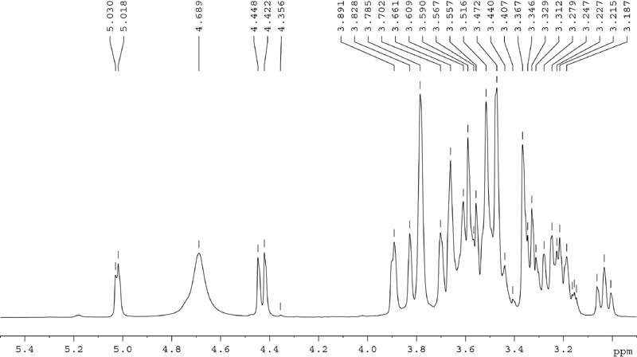
¹H Spectrum of Mountain Dew

Slide 8
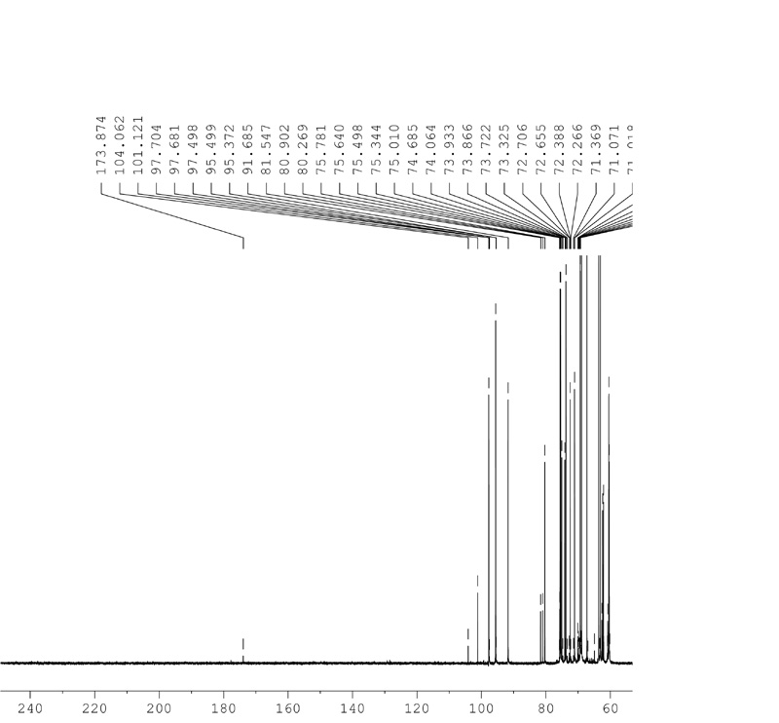
¹³C Spectrum of Mountain Dew

Slide 9
NMR Spectra Interpretation
Tables 12.1 (p. 255) and 12.3 (p. 260) contain H and C chemical shifts respectively.
Table 12.2 (p. 256) contains spin-spin coupling constants.

Slide 10
Lab Procedure
(students follow own handout)
1. You will work with a partner
2. Each person will have an unknown. If there is a group of three there will be three unknowns given to that group.
3.The TA will assign unknowns.
4. The NMR spectra of the unknown will be provided to you. They are also available on a course web page.
5. You will need to do the IR for that unknown.
6. The unknown will be either liquid or solid. For liquid unknowns you will use the silver chloride plates (you should have seen this last semester), for solid unknowns you will need to make a KBr pellet.

Slide 11
The End

