Slide 1
Mr. Shaikh Amjad R.
Asst. Prof in Dept. of Computer Sci.
Mrs. K.S.K College Beed
Software Processes

Slide 2
Topics covered
Software process models
Process activities
Coping with change
The Rational Unified Process
  An example of a modern software process.

Slide 3
The software process
A structured set of activities required to develop a
software system.
Many different software processes but all involve:
  Specification – defining what the system should do;
  Design and implementation – defining the organization of the system and implementing the system;
  Validation – checking that it does what the customer wants;
  Evolution – changing the system in response to changing customer needs.
A software process model is an abstract representation of a process. It presents a description of a process from some particular perspective.

Slide 4
Software process descriptions
When we describe and discuss processes, we usually talk about the activities in these processes such as specifying a data model, designing a user interface, etc. and the ordering of these activities.
Process descriptions may also include:
  Products, which are the outcomes of a process activity;
  Roles, which reflect the responsibilities of the people involved in the process;
  Pre- and post-conditions, which are statements that are true before and after a process activity has been enacted or a product produced.

Slide 5
Software process models
The waterfall model
  Plan-driven model. Separate and distinct phases of specification and development.
Incremental development
  Specification, development and validation are interleaved. May be plan-driven or agile.
Reuse-oriented software engineering
  The system is assembled from existing components. May be plan-driven or agile.
In practice, most large systems are developed using a process that incorporates elements from all of these models.

Slide 6
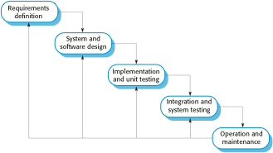
The waterfall model

Slide 7
Waterfall model phases
There are separate identified phases in the waterfall model:
  Requirements analysis and definition
  System and software design
  Implementation and unit testing
  Integration and system testing
  Operation and maintenance
The main drawback of the waterfall model is the difficulty of accommodating change after the process is underway. In principle, a phase has to be complete before moving onto the next phase.

Slide 8
Waterfall model problems
Inflexible partitioning of the project into distinct stages makes it difficult to respond to changing customer requirements.
  Therefore, this model is only appropriate when the requirements are well-understood and changes will be fairly limited during the design process.
  Few business systems have stable requirements.
The waterfall model is mostly used for large systems engineering projects where a system is developed at several sites.
  In those circumstances, the plan-driven nature of the waterfall model helps coordinate the work.

Slide 9
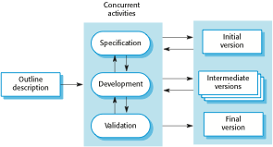
Incremental development

Slide 10
Incremental development benefits
The cost of accommodating changing customer requirements is reduced.
  The amount of analysis and documentation that has to be redone is much less than is required with the waterfall model.
It is easier to get customer feedback on the development work that has been done.
  Customers can comment on demonstrations of the software and see how much has been implemented.
More rapid delivery and deployment of useful software to the customer is possible.
  Customers are able to use and gain value from the software earlier than is possible with a waterfall process.

Slide 11
Incremental development problems
The process is not visible.
  Managers need regular deliverables to measure progress. If systems are developed quickly, it is not cost-effective to produce documents that reflect every version of the system.
System structure tends to degrade as new increments are added.
  Unless time and money is spent on refactoring to improve the software, regular change tends to corrupt its structure. Incorporating further software changes becomes increasingly difficult and costly.

Slide 12
Software specification
The process of establishing what services are required and the constraints on the system’s operation and development.
Requirements engineering process
  Feasibility study
    Is it technically and financially feasible to build the system?
  Requirements elicitation and analysis
    What do the system stakeholders require or expect from the system?
  Requirements specification
    Defining the requirements in detail
  Requirements validation
    Checking the validity of the requirements

Slide 13
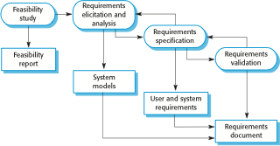
The requirements engineering process

Slide 14
Software design and implementation
The process of converting the system specification into an executable system.
Software design
  Design a software structure that realises the specification;
Implementation
  Translate this structure into an executable program;
The activities of design and implementation are closely related and may be inter-leaved.

Slide 15
Software prototyping
A prototype is an initial version of a system used to demonstrate concepts and try out design options.
A prototype can be used in:
  The requirements engineering process to help with requirements elicitation and validation;
  In design processes to explore options and develop a UI design;
  In the testing process to run back-to-back tests.

Slide 16
Benefits of prototyping
Improved system usability.
A closer match to users’ real needs.
Improved design quality.
Improved maintainability.
Reduced development effort.

Slide 17

The process of prototype development

Slide 18
Prototype development
May be based on rapid prototyping languages or tools
May involve leaving out functionality
  Prototype should focus on areas of the product that are not well-understood;
  Error checking and recovery may not be included in the prototype;
  Focus on functional rather than non-functional requirements such as reliability and security

Slide 19
Incremental delivery
Rather than deliver the system as a single delivery, the development and delivery is broken down into increments with each increment delivering part of the required functionality.
User requirements are prioritised and the highest priority requirements are included in early increments.
Once the development of an increment is started, the requirements are frozen though requirements for later increments can continue to evolve.

Slide 20
Incremental development and delivery
Incremental development
  Develop the system in increments and evaluate each increment before proceeding to the development of the next increment;
  Normal approach used in agile methods;
  Evaluation done by user/customer proxy.
Incremental delivery
  Deploy an increment for use by end-users;
  More realistic evaluation about practical use of software;
  Difficult to implement for replacement systems as increments have less functionality than the system being replaced.

Slide 21
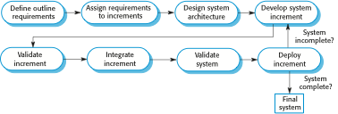
Incremental delivery

Slide 22
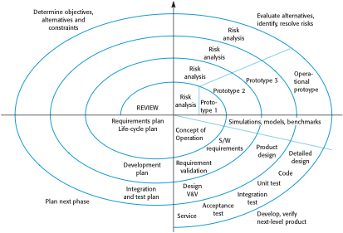
Boehm’s spiral model of the software process

Slide 23
Spiral model sectors
Objective setting
  Specific objectives for the phase are identified.
Risk assessment and reduction
  Risks are assessed and activities put in place to reduce the key risks.
Development and validation
  A development model for the system is chosen which can be any of the generic models.
Planning
  The project is reviewed and the next phase of the spiral is planned.

Slide 24
Spiral model usage
Spiral model has been very influential in helping people think about iteration in software processes and introducing the risk-driven approach to development.
In practice, however, the model is rarely used as published for practical software development.

