Slide 1
Dr. S.V. Lamture
Wel Come
Department of Chemistry

Slide 2
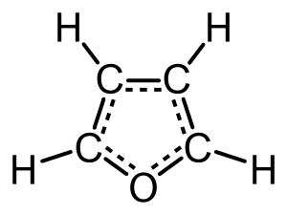
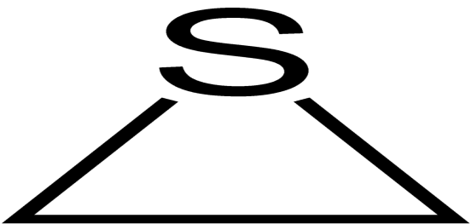
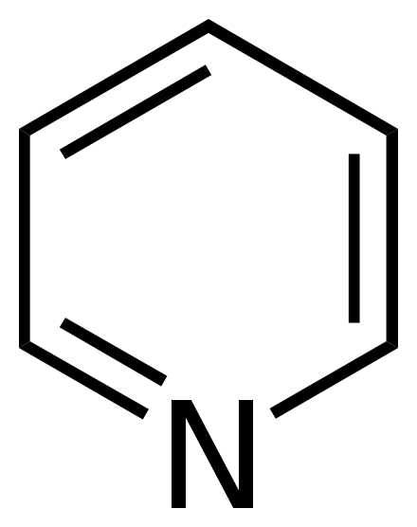
Heterocyclic Compound
A heterocyclic compound or ring structure is a cyclic compound that has atoms of at least two different elements as members of its rings.
Heterocyclic compound are cyclic compounds in which the ring atoms are of carbon and some other element. The atom of the other element (for example: N , S , or O) is called the Hetero atom.
For example: Pyrrole, Furan , Thiophene, Indole , pyridine , Quinoline ,etc.
Thiiran
Pyridine
Furan

Slide 3
Three Membered Rings compounds
Four Membered Rings compounds
Five Membered Rings compounds
Six Membered Rings compounds
Seven Membered Rings compounds
Classification of Heterocyclic compounds according to it’s membered

Slide 4
Pyrrole (Azole) C₄H₅N
The pyrrole ring system is important as it is found in many natural products including hemoglobin, chlorophyll, and alkaloids.
According to the resonance theory ,pyrrole is considered to be hybrid of the following five resonance structures.

Slide 5
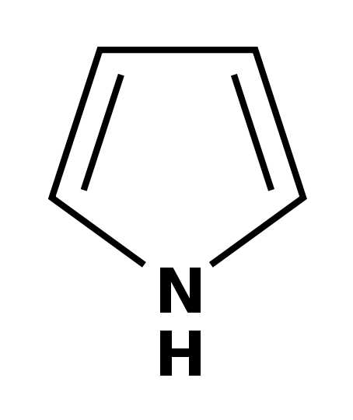
Preparation of Pyrrole
Pyrrole is obtained :
Industrially pyrrole is obtained by passing a mixture of furan and ammonia over alumina at 400 °C.
Pyrrole can be obtained by heating
2-bytyne-1,4-diol with ammonia under pressure.
Al₂O₃
Furan
Pyrrole
Pyrrole

Slide 6
Properties of Pyrrole
Physical properties of Pyrrole discussed below it:
It is a colourless volatile liquid.
It’s boiling point is 131°C and melting point is -23°C.
It turns brown in the air and gradually resinifies.
Only slightly soluble in water but it is totally miscible with ether and ethanol.
Pyrrole is weakly basic in nature.
Chemical properties of pyrrole discussed below it:
Pyrrole is aromatic and more reactive than benzene.
It gives electrophilic substitution reactions such as halogenation , nitration ,etc.
It also undergoes diazotization and Reimer-Tiemann reactions, while benzene does not.

Slide 7
Uses of Pyrrole
Pyrrole is essential to the production of many different chemicals.
N-methylpyrrole is a precursor to N-methylpyrrolecarboxylic acid, a building-block in pharmaceutical chemistry.
Although there is a claim that pyrrole is used as an additive to cigarettes, it is typically listed as a constituent of tobacco smoke and not as an ingredient.
Pyrrole is also use in commercial and pharmaceuticals.

Slide 8
The End

