Slide 1
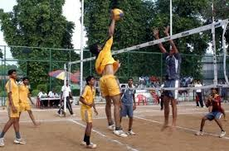
WEL COME
Dr. Udhav Kale
Department of PHYSICAL EDUCATION

Slide 2


Physical Education, Exercise Science and Sport: The Profession
Profession…
  An occupation requiring specialized training in an intellectual field of study that is dedicated to the betterment of society through service to others.
Some examples of professional organizations:

Slide 3
Organizing The Profession
With developing technologies, knowledge, and methods of inquiry from other disciplines in the 1960s, physical education, exercise science, and sport broadened its horizons to incorporate the fields of psychology and sociology.
The result:12 subdisciplines

Slide 4
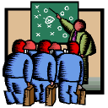


Subdisciplines
Exercise physiology
Sports medicine
Sport biomechanics
Sport philosophy
Sport history
Sport psychology
Motor development
Motor learning
Sport sociology
Sport pedagogy
Adapted physical activity
Sport management
Notes:
7

Slide 5
Exercise Physiology
Impact of exercise and physical activity on the human body.
Short- and long-term adaptations of the various systems of the body.
Effects of physical activity and exercise on the health status of different populations.
ACSM:
Notes:
11

Slide 6


Sports Medicine
Medical relationship between physical activity, sports-related injuries, and the human body.
Prevention - the design of conditioning programs, fitting of protective equipment, and counseling regarding proper nutrition.
Treatment and rehabilitation - the assessment of injuries, administration of first aid, design and implementation of rehabilitation program and treatment.
Notes:
10

Slide 7
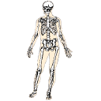
Sport Biomechanics
Applies the methods of physics to the study of human motion and the motion of sport objects.
Study the effects of force on the body and sport objects.
Mechanical analysis of activities (production of power, leverage, and stability)
Analysis of effectiveness and efficiency of movements
Notes:
13

Slide 8
Sport Philosophy
Study of the nature of reality and values of movement for all participants.
Debate critical issues, beliefs, and values relative to physical education and sport (i.e.What is the relationship between the mind and the body?).
Influences thoughts, actions, and decisions in our professional endeavors and personal lives.
Notes:
12

Slide 9

Sport History
Critical examination of the past with a focus on events, people, and trends that influenced the direction of the field.
The “who, what, when, where, how, and why of sport” is examined within the social context of the time.
Looking into the past provides greater understanding of present events and insight with respect to the future.
NASSH: North American Society for Sport History publishes the Journal of Sport History.
Notes:
15

Slide 10

Motor Development
Interaction of genetic and environmental influences on movement and lifespan motor development.
Use theories of development to design appropriate movement experiences for people of all ages and abilities.
Notes:
17

Slide 11
END

