Slide 1
Organ metallic
Compounds
By,
Dr. S.V. Lamture
Dept Of Chemistry

Slide 2
Organometallic Compounds
Organometallic compound: a compound that contains a carbon-metal bond
In this chapter, we focus on organometallic compounds of Mg, Li, and Cu
  these classes illustrate the usefulness of organometallics in modern synthetic organic chemistry
  they illustrate how the use of organometallics can bring about transformations that cannot be accomplished in any other way
  several more recent reactions of organometallic Compounds

Slide 3
Organometallic Reagents
The Key Concepts:
Make a carbon negatively charged/polarlized so it is nucleophilic.
Reaction with electrophilic carbons can make carbon-carbon bonds

Slide 4
The First Organometallic Reagents
Grignard Reagents
Discovered by Victor Grignard Grignard Reagents
in 1900
  Key factors are ethereal solvent and water-free conditions
Awarded Nobel Prize in 1912

Slide 5
Grignard Reagents
Grignard reagent: an organomagnesium compound
  prepared by addition of an alkyl, aryl, or alkenyl (vinylic) halide to Mg metal in diethyl ether or THF

Slide 6
An Alternative to Grignard Reagents are Alkyl Lithiums

Slide 7
Grignard and Organolithium Reagents
Given the difference in electronegativity between carbon and magnesium (lithium), the C-Mg (C-Li) bond is polar covalent, with C^{δ-} and Mg^{δ+} ( Li^{δ+} )
  Grignard and organolithium reagents behave like carbanions
Carbanion: an anion in which carbon has an unshared pair of electrons and bears a negative charge
Notes:
23
23
23

Slide 8
Thanks

Slide 9
Grignard and Organolithium Reagents
Carbanion: an anion in which carbon has an unshared pair of electrons and bears a negative charge
  Carbanions are strong bases--they are easily quenched by even very weak acids (water, alcohols, amines, amides, carboxylic acids, even terminal alkynes). A limitation to utility!
Notes:
23
23
23

Slide 10
Grignard and Organolithium Reagents
Carbanion: an anion in which carbon has an unshared pair of electrons and bears a negative charge
  Carbanions are strong bases--they are easily quenched by even very weak acids (water, alcohols, amines, carboxylic acids, amides, even terminal alkynes). A limitation to utility!
Notes:
23
23
23

Slide 11
Limitations
Can’t make Grignards with acidic or electro-philic functional groups present in the molecule:
R₂NH pK_{a} 38-40
Terminal Alkynes pK_{a} 25
ROH pK_{a} 16-18
Carbonyls & Nitros pK_{a} 11-27

Slide 12
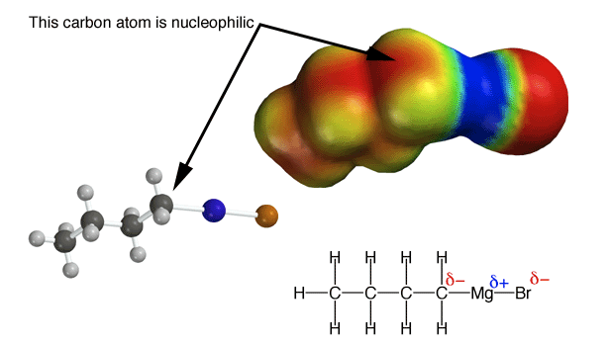
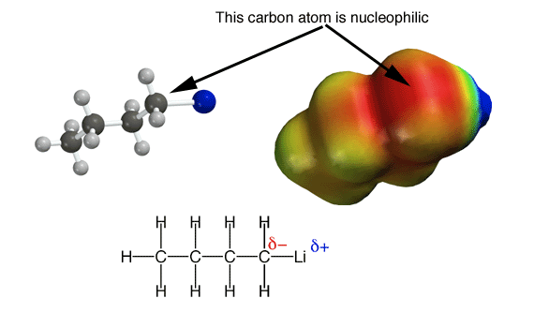
Grignard and Organolithium Reagents
Carbanion: an anion in which carbon has an unshared pair of electrons and bears a negative charge
  Carbanions are also great nucleophiles. This is the reason for their great utility!

