Slide 1
Indian Light Music
By Deepak Jamdhade
Raut sachin

Slide 2
Starting from finest of melodies to Dappanguthu, every song has one or more Ragas associated with it. From the bird’s eye view A Raga is a series of five or more musical notes upon which a melody is made.
So what differentiates the Classical music from the Filmy music?

Slide 3
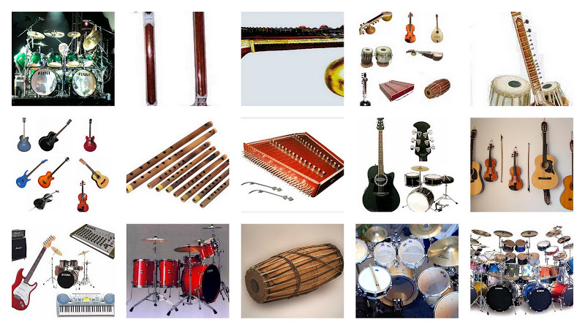

Slide 4
Classical Music has its origin rooted deep into Indian history and tradition. Thats why it is often referred to as traditional music (pandhadhi). It follows strict rules and aesthetics. Especially the life (Jeeva) of Carnatic and Hindustani music lies on that special aspect called Gamaka. The unique character of each raga is given by its gamakas, making their role essential rather than decorative in Indian music. The cine/light songs are totally devoid of these gamakas.

Slide 5
We also have practice of using Anya swaras in Carnatic and Hindustani, but they are well defined for a raga and again bound to rules. Example,
Mishra Shiva Ranjani, Bilahari, etc., The literal meaning of the term “Mishra” is mixed. Mishra ragas are often referred to as Bashanga ragas in carnatic. Example of some of the mishra ragas are Mishra mand, Mishra peelu, Mishra kapi, etc

Slide 6
There are some differences in way of singing (say culturing the voice), between the classical and light music. As the name suggests, light music is always sung light without any depth in singing. Mostly the sound emerges from the throat. However in carnatic, the sound emanates from the umblical cord (Naabhi) and travels through the chest then to the throat.
Stated clearly in the following kriti,
“Naabhi hrud kanta rasana”.

Slide 7
A breathing technique called Pranayama helps in acheiving this.
And there is no doubt that, people who are trained in classical have an edge over those who only sing light, especially in voice culture, knowledge, identifying swaras, and other technical aspects. They can adapt to light with ease.
But on the contrary it is a great challenge for those who sing only light to adapt themselves for singing carnatic. To quote an analogy, A person knowing marine swimming, can adapt easily and swim in a swimming pool but the converse is not true.

Slide 8
The trend of cinema music has been continuously changing from the days of pure classical music being adopted in movies (Sampoorna Ramayana, Lava kusa, etc) to modern rap and Jazz music. It is becoming more westernized and less classical day by day.
Nowadays, only Rahman’s and Ilayaraja’s songs makes sense to be mapped to the Raga domain. Thanks Rahman & Ilayaraja for that.

