Slide 1
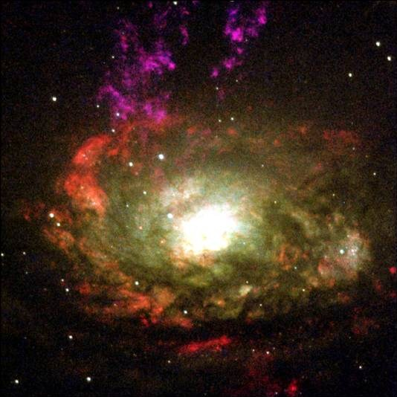
Indian Musical Instruments
Deepak Jamdhade
Raut sachin

Slide 2
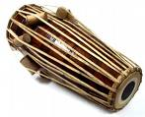
Pakhawaj
The North Indian version of the Mridangam
Used for Orissi and Kathak dancing
One side of the drum is larger than the other
Notes:
the larger bass-skin is played with the left hand, the treble skin by the right hand. ←----treble, bass, like a piano
The goatskin membranes are looped with leather thongs around the hollowed barrel, which is widest in the middle.
treble skin is fitted with three concentric rings of dense black hardened paste

Slide 3
Tabla
A set of two drums
The drum for the right hand is a dayan
The drum for the left hand is called a bayan
The bayan is typically made of metal, iron, aluminium, copper, steel, or clay
The dayan is typically made of wood
Notes:
Dayan- made of hollowed out teak and rosewood
Bayan- brass, copper, aluminum, or steel along with clay
The heads of both drums are covered with goat skin
syahi- center of the head of the drum, made of tuning paste (contains starch and a black powder)

Slide 4
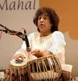

Zakir Hussain

Slide 5

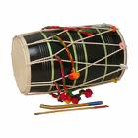
Dhol
Used for formal Bhangra performances
The drum is slung over the neck of the player with a strap usually made up of ropes or woven cloth
You play with two wooden sticks
double-sided barrel drum
Notes:
different woods and materials (fiberglass, Steel, Plastic) according to region
The sticks are made of cane wood and bamboo

Slide 6
Harmonium
Uses air to play music - a bellow
Keys are similar to that of a piano except smaller
You play with one hand, bellow with the other
Accompanied by a tabla
Notes:
consist of banks of brass reeds (metal tongues which vibrate when air flows over them),
a pumping apparatus ----bellow
keyboard.

Slide 7
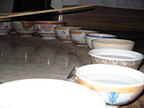
Jal Tarang
Has many factors that affect the sound produced-cups, amount of water and sticks
Pitch is set by adjusting volume of water in a cup
Cups can be made of porcelain, bronze, or China

Slide 8


Slide 9
Tanpura
Has many different names according to region
Also known as Tambura (South India)
Resembles a sitar, but has no frets
Designed in three different styles: Miraj, Tanjore, and Tamburi – In Miraj and Tanjore styles, the Tanpura is 3-5 feet long, but in the Tamburi style, it is 2-3 feet long
Notes:
It usually has a resonator made of a gourd, but rarely one may find resonators made of wood.
Ask them what a resonator is!!!! It the hollowness of the gourd/wood that makes it echo

Slide 10
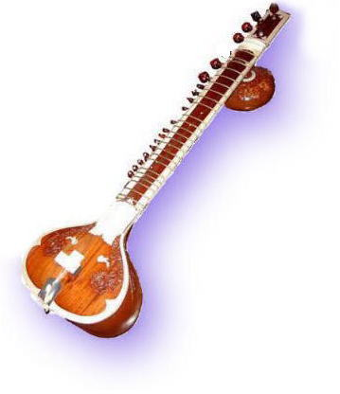
Sitar
Balanced between the player's left foot and right knee
Plucked string instrument
The surbahar is a larger sitar with a broader fret-board and thicker strings.
Has frets
Notes:
Made of teak, mahogany, bones, gourd and metal.
Metal frets are tied by silk or nylon string
strings made of steel, brass, and copper

Slide 11
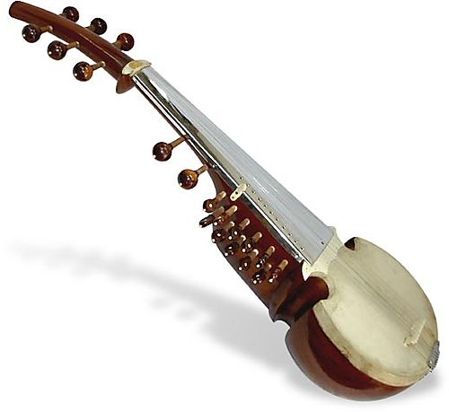
Sarod
Stringed instrument
No frets
Mohammad Hashmi Khan Bangash brought the Afghan rabab to India
Over the centuries, the rabab evolved into the Sarod we know today
Notes:
Most are made of teak like a sitar
the front of the wooden belly is covered with goat skin.

Slide 12

Ektara
String instrument
Played with one finger
Traditionally used for Kirtan chanting, a practice of Hindu devotional singing
A two stringed Ektara is called a dotara
Notes:
made of dried pumpkin/gourd, wood or coconut←-------------the circle
Split bamboo cane←-----------neck

Slide 13

Shanai
Believed to have originated in the Kashmir Valley
Created by improving the pungi- a woodwind instrument used by snake charmers
Derived from the Persian words “Sheh” (King) and “Nai” (Flute) to mean “King’s flute”
Uses two sets of double reeds
Thought to bring good luck-marriages and processions

Slide 14
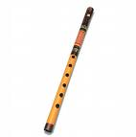
Bamboo Flute
Two versions- Bansuri and Venu
Bansuri-six finger holes
Venu- eight finger holes
Requires a specific type of bamboo

Slide 15

Violin
Not native to India, but has
techniques of playing that are
South Indian technique-instead of holding the instrument under the chin, the musician props it between the shoulder and the foot.
North Indian technique is not as refined

Slide 16

Esraj
Has different variations depending on location
Dilruba is the northern variation
Has a sitar-like neck and 20 metal frets

Slide 17

Veena
Different variations-Saraswati, Mohan, Rudra, etc
Has frets
Connected with religion- Saraswati plays it and Narada was a veena maestro, and Ravan was a versatile player
Notes:
Gourd, connected with religion

Slide 18

Ghungroos
Used in dance, primarily in bharatnatyam, kuchipudi, odissi, and kathak.
A novice may start out with 50 bells on their ghungroos, but may add more as their level of experience increases
the total number of bells on ghungroos can be >200
Made of small metallic bells

Slide 19
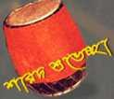
Notes:
Big quiz

Slide 20
Percussion Instruments
Notes:
quiz

