Slide 1
Elementary Quantum Mechanics
Mr. Sonaji V. Gayakwad
Asst. professor
Dept of chemistry
Mrs.K.S.K. College,Beed

Slide 2
Black Body Radiation
INTRODUCTION:
A black body is a theoretical object that absorbs 100% of the radiation that hits it. Therefore it reflects no radiation and appears perfectly black.
In practice no material has been found to absorb all incoming radiation, but carbon in its graphite form absorbs all but about 3%. It is also a perfect emitter of radiation.
At a particular temperature the black body would emit the maximum amount of energy possible for that temperature. This value is known as the black body radiation.
A simple example of a black body radiator is the furnace. If there is a small hole in the door of the furnace heat energy can enter from the outside. Inside the furnace this is absorbed by the inside walls. The walls are very hot and are also emitting thermal radiation. This may be absorbed by another part of the furnace wall or it may escape through the whole in the door.
Stars are also approximate black body radiators. Most of the light directed at a star is absorbed. It is therefore capable of absorbing all wavelengths of electromagnetic radiation, so is also capable of emitting all wavelengths of electromagnetic radiation.
Most approximate blackbodies are solids but stars are an exception because the gas particles in them are so dense they are capable of absorbing the majority of the radiant energy.

Slide 3
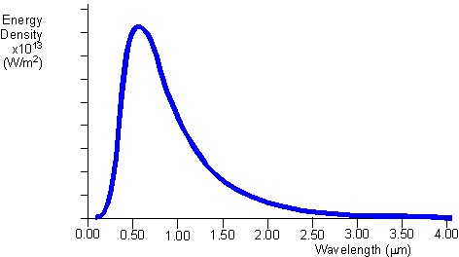
Black Body Radiation curves

Slide 4
BLACK BODY RADIATION CURVES
The black body radiation curve (Fig1) shows that the black body does radiate energy at every wavelength. The curve gets infinitely close to the x-axis but never touches it. The curve touches at infinite wavelength. It also shows that the black body emits at a peak wavelength, at which most of the radiant energy is emitted. At 5000K the peak wavelength is about 5x10⁻⁷m (500nm) which is in the visible light region, in the yellow-green section. At each temperature the black body emits a standard amount of energy. This is represented by the area under the curve.

Slide 5
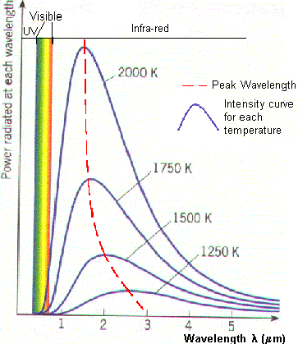

Slide 6
BLACK BODY RADIATION CURVES
This graph shows how the black body radiation curves change at various temperatures. These all have their peak wavelengths in the infra-red part of the spectrum as they are at a lower temperature than the previous graph.
The graph shows.
As the temperature increases, the peak wavelength emitted by the black body decreases.
As temperature increases, the total energy emitted increases, because the total area under the curve increases.

Slide 7
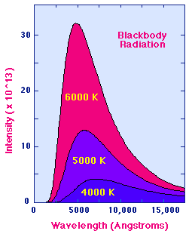
Planck Radiation Law
The average or bulk properties of electromagnetic radiation interacting with matter are systematized in a simple set of rules called radiation laws. These laws apply when the radiating body is what physicists call a blackbody radiator. Generally, blackbody conditions apply when the radiator has very weak interaction with the surrounding environment and can be considered to be in a state of equilibrium. Although stars do not satisfy perfectly the conditions to be blackbody radiators, they do to a sufficiently good approximation that it is useful to view stars as approximate blackbody radiators.

Slide 8
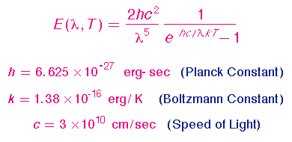
Radiation Laws
The primary law governing blackbody radiation is the Planck Radiation Law, which governs the intensity of radiation emitted by unit surface area into a fixed direction (solid angle) from the blackbody as a function of wavelength for a fixed temperature. The Planck Law can be expressed through the following equation.
The behavior is illustrated in the figure shown above. The Planck Law gives a distribution that peaks at a certain wavelength, the peak shifts to shorter wavelengths for higher temperatures, and the area under the curve grows rapidly with increasing temperature.

Slide 9
Photoelectric Effect
A Photocell is Used to Study the Photoelectric Effect

Slide 10
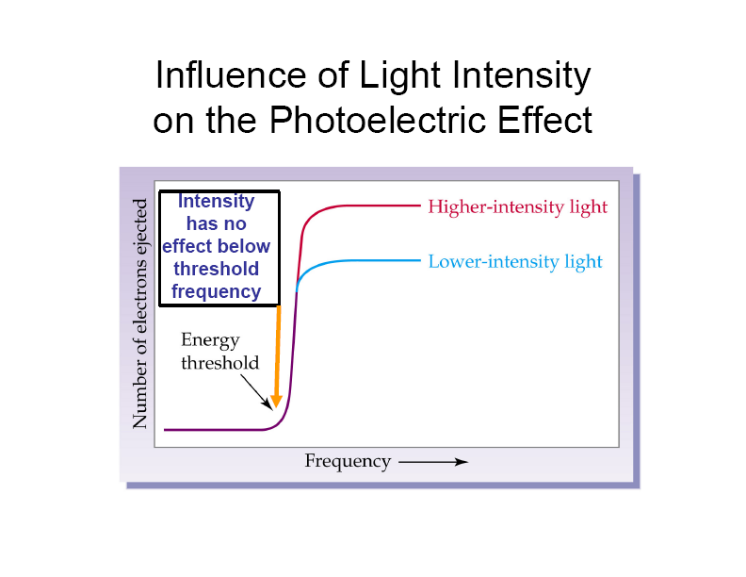
Photoelectric Effect
Larger light intensity means larger number of photons at a given frequency (Energy)

Slide 11
Photoelectric Effect

Slide 12
Photoelectric Effect
  The photoelectric effect provides evidence for the particle nature of light.
  It also provides evidence for quantization.
  If light shines on the surface of a metal, there is a point at which electrons are ejected from the metal.
  The electrons will only be ejected once the threshold frequency is reached .
  Below the threshold frequency, no electrons are ejected.
  Above the threshold frequency, the number of electrons ejected depend on the intensity of the light.

Slide 13
Thanks

