Slide 1
E-COMMERCE
BY
GAWARE S.R.
DEPT.OF COMP.SCI

Slide 2
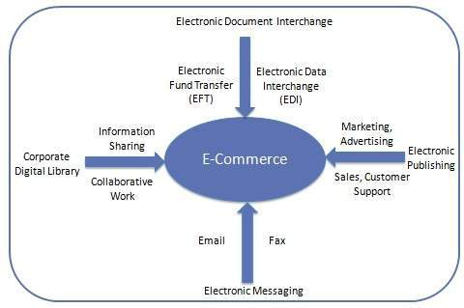
INTRODUCTION:
E-Commerce or Electronics Commerce is a methodology of modern business, which addresses the requirements of business organizations. It can be broadly defined as the process of buying or selling of goods or services using an electronic medium such as the Internet.
Ecommerce refers to the paperless exchange of business information using the following ways −
Electronic Data Exchange (EDI)
Electronic Mail (e-mail)
Electronic Bulletin Boards
Electronic Fund Transfer (EFT)
Other Network-based technologies

Slide 3
Features:
E-Commerce provides the following features −
Non-Cash Payment − E-Commerce enables the use of credit cards, debit cards, smart cards, electronic fund transfer via bank's website, and other modes of electronics payment.
24x7 Service availability − E-commerce automates the business of enterprises and the way they provide services to their customers. It is available anytime, anywhere.
Advertising / Marketing − E-commerce increases the reach of advertising of products and services of businesses. It helps in better marketing management of products/services.
Improved Sales − Using e-commerce, orders for the products can be generated anytime, anywhere without any human intervention. It gives a big boost to existing sales volumes.
Support − E-commerce provides various ways to provide pre-sales and post-sales assistance to provide better services to customers.
Inventory Management − E-commerce automates inventory management. Reports get generated instantly when required. Product inventory management becomes very efficient and easy to maintain.
Communication improvement − E-commerce provides ways for faster, efficient, reliable communication with customers and partners.

Slide 4
SECURITY:
Security is an essential part of any transaction that takes place over the internet. Customers will lose his/her faith in e-business if its security is compromised. Following are the essential requirements for safe e-payments/transactions −
Confidentiality − Information should not be accessible to an unauthorized person. It should not be intercepted during the transmission.
Integrity − Information should not be altered during its transmission over the network.
Availability − Information should be available wherever and whenever required within a time limit specified.
Authenticity − There should be a mechanism to authenticate a user before giving him/her an access to the required information.
Non-Repudiability − It is the protection against the denial of order or denial of payment. Once a sender sends a message, the sender should not be able to deny sending the message. Similarly, the recipient of message should not be able to deny the receipt.
Encryption − Information should be encrypted and decrypted only by an authorized user.
Auditability − Data should be recorded in such a way that it can be audited for integrity requirements.

Slide 5
Encryption − It is a very effective and practical way to safeguard the data being transmitted over the network. Sender of the information encrypts the data using a secret code and only the specified receiver can decrypt the data using the same or a different secret code.
Digital Signature − Digital signature ensures the authenticity of the information. A digital signature is an e-signature authenticated through encryption and password.
Security Certificates − Security certificate is a unique digital id used to verify the identity of an individual website or user.

Slide 6
Secure Socket Layer (SSL):
It is the most commonly used protocol and is widely used across the industry. It meets following security requirements −
Authentication
Encryption
Integrity
Non-reputability
Secure Hypertext Transfer Protocol (SHTTP):
SHTTP extends the HTTP internet protocol with public key encryption, authentication, and digital signature over the internet. Secure HTTP supports multiple security mechanism, providing security to the end-users. SHTTP works by negotiating encryption scheme types used between the client and the server.

Slide 7
Secure Electronic Transaction:
It is a secure protocol developed by MasterCard and Visa in collaboration. Theoretically, it is the best security protocol. It has the following components −
Card Holder's Digital Wallet Software − Digital Wallet allows the card holder to make secure purchases online via point and click interface.
Merchant Software − This software helps merchants to communicate with potential customers and financial institutions in a secure manner.
Payment Gateway Server Software − Payment gateway provides automatic and standard payment process. It supports the process for merchant's certificate request.
Certificate Authority Software − This software is used by financial institutions to issue digital certificates to card holders and merchants, and to enable them to register their account agreements for secure electronic commerce.

