Slide 1
Dr. S. B Maulage
Dept of Chemistry

Slide 2
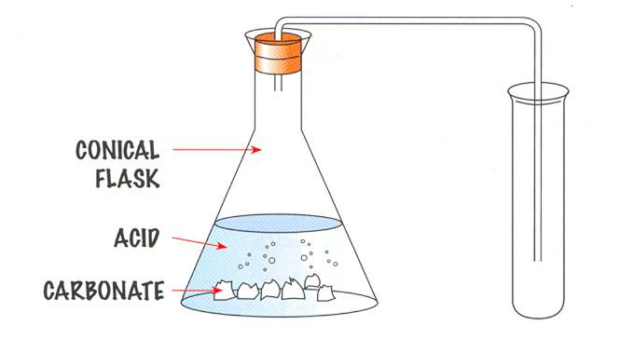

Slide 3
Dipole Moment & Molecular structure
Definition:
“ The product of charges and the distance between the charges”.
Dipole Moment is a measure of the degree of Polarity of a molecule.

Slide 4
Introduction
Dipole moment (µ) is the measure of net molecular polarity, which is the magnitude of the charge Q at either end of the molecular dipole times the distance r between the charges.
µ= Q X r

Slide 5
Dipole moments tell us about the charge separation in a molecule. The larger the difference in electronegativities of bonded atoms, the larger the dipole moment. For example, NaCl has the highest dipole moment because it has an ionic bond (i.e. highest charge separation).

Slide 6
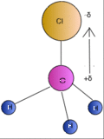
Ex. In CH₃Cl molecule, chlorine is more electronegative than carbon, thus attracting the electrons in the C—Cl bond toward itself (Figure 1). As a result, chlorine is slightly negative and carbon is slightly positive in C—Cl bond. Since one end of C-Cl is positive and the other end is negative, it is described as a polar bond.

Slide 7
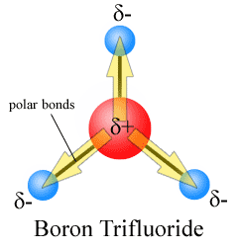
Another Exampe

Slide 8
For diatomic molecules there is only one (single or multiple) bond so the bond dipole moment is the molecular dipole moment, with typical values in the range of 0 to 11 D. At one extreme, a symmetrical molecule such as chlorine, Cl
2, has zero dipole moment, while near the other extreme, gas phase potassium bromide, KBr, which is highly ionic, has a dipole moment of 10.5 D

Slide 9
For polyatomic molecules there is more than one bond, and the total molecular dipole moment may be approximated as the vector sum of individual bond dipole moments. Often bond dipoles are obtained by the reverse process: a known total dipole of a molecule can be decomposed into bond dipoles. This is done to transfer bond dipole moments to molecules that have the same bonds, but for which the total dipole moment is not yet known. The vector sum of the transferred bond dipoles gives an estimate for the total (unknown) dipole of the molecule.

Slide 10
Dipole Moments of Some Compounds
Compound | Dipole Moment (Debyes)
NaCl | 9.0
CH₃Cl | 1.87
H₂O | 1.85
NH₃ | 1.47
CO₂ | 0
CCl₄ | 0

Slide 11
Polar molecules and Dipole-Dipole Interaction
A polar molecule is a molecule where one end has a positive electrical charge and the other end has a negative charge due to the arrangement or geometry of its atoms. Because polar molecules have a positive and negative charge ends, the positive charge end of a molecule will attract to the negative end of adjacent molecule with the same or different kind of molecule. The attraction beween two polar molecules is called dipole-dipole interaction. The attraction between two dipoles create a very strong intermolecular force, which have great influence in the evaporation of liquid and condensation of gas.

Slide 12
For example, Since water are polar molecules, the interaction between water molecules are so strong that it takes a lot of energy to break the bond between the water molecules. Therefore, the boiling point of polar substances are higher than those of nonpolar substance due to stronger intermolecular force among polar molecules.

Slide 13
Mathematical Expression
u = q x r
u – Dipole moment
q– Charge on the atoms
r– distance betw. The charges

Slide 14
Units of Dipole Moment
CGS Unit :
‘Debyes’ – denoted by -‘D’
1 D = 10⁻¹⁸ esu.cm
q = 10⁻¹⁰ esu
r = 10⁻⁸ cm

Slide 15
SI - Unit
SI unit is ‘Coulomb Meter’
1D = 3.336 x 10⁻³⁰ C . M.

Slide 16
Dipole moment is Vector quantity having magnitude and direction

Slide 17
Dipole Moment of of CHCL₃
Therefore, polar molecules have...
– asymmetrical shape (lone pairs) or
– asymmetrical atoms

Slide 18
Identification of Ortho, meta, para Isomers:
Bi-substituted Benzene has three isomers i.e.
Ortho,
Meta,
Para – substituted benzene.

Slide 19
ortho – substituted benzene.
u = 2.6 D
Cl
Cl

Slide 20
meta – substituted benzene.
u = 1.5 D
Cl
Cl

Slide 21
para – substituted benzene.
u = 0 D
Cl
Cl

Slide 22
THE END
Thank You !,
- Mr. Maulage S . B.

