Slide 1
Database Management System
BY
GAWARE S.R.
DEPT. OF COMP.SCI

Slide 2
Database Management System:
Database Management System or DBMS in short refers to the technology of storing and retrieving users’ data with utmost efficiency along with appropriate security measures. This tutorial explains the basics of DBMS such as its architecture, data models, data schemas, data independence, E-R model, relation model, relational database design, and storage and file structure and much more.
Data models:
Data models define how the logical structure of a database is modeled. Data Models are fundamental entities to introduce abstraction in a DBMS. Data models define how data is connected to each other and how they are processed and stored inside the system.
Entity-Relationship Model:
Entity-Relationship (ER) Model is based on the notion of real-world entities and relationships among them. While formulating real-world scenario into the database model, the ER Model creates entity set, relationship set, general attributes and constraints.
ER Model is best used for the conceptual design of a database.
ER Model is based on −
Entities and their attributes.
Relationships among entities.

Slide 3
Entity − An entity in an ER Model is a real-world entity having properties called attributes. Every attribute is defined by its set of values calleddomain. For example, in a school database, a student is considered as an entity. Student has various attributes like name, age, class, etc.
Relationship − The logical association among entities is calledrelationship. Relationships are mapped with entities in various ways. Mapping cardinalities define the number of association between two entities.
Mapping cardinalities −
one to one
one to many
many to one
many to many

Slide 4
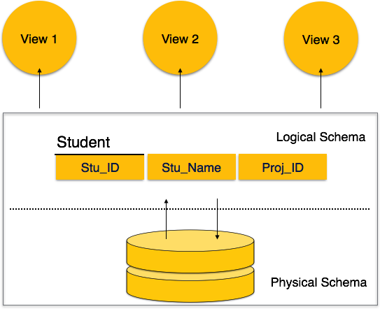
Database Schema
A database schema is the skeleton structure that represents the logical view of the entire database. It defines how the data is organized and how the relations among them are associated. It formulates all the constraints that are to be applied on the data.
A database schema defines its entities and the relationship among them. It contains a descriptive detail of the database, which can be depicted by means of schema diagrams. It’s the database designers who design the schema to help programmers understand the database and make it useful.

Slide 5
A database schema can be divided broadly into two categories −
Physical Database Schema − This schema pertains to the actual storage of data and its form of storage like files, indices, etc. It defines how the data will be stored in a secondary storage.
Logical Database Schema − This schema defines all the logical constraints that need to be applied on the data stored. It defines tables, views, and integrity constraints.

Slide 6
SQL: (STRUCTURED QUREE LANGUAGE)
SQL is a programming language for Relational Databases. It is designed over relational algebra and tuple relational calculus. SQL comes as a package with all major distributions of RDBMS.
SQL comprises both data definition and data manipulation languages. Using the data definition properties of SQL, one can design and modify database schema, whereas data manipulation properties allows SQL to store and retrieve data from database.
CREATE
Creates new databases, tables and views from RDBMS.
For example −
Create database tutorials point; Create table article; Create view for students; DROP
Drops commands, views, tables, and databases from RDBMS.
For example−
Drop object type object name; Drop database tutorials point; Drop table article; Drop view for students; ALTER
Modifies database schema.
Alter object type object name parameters;
For example− Alter table article add subject varchar;

Slide 7
Data Manipulation Language:
SQL is equipped with data manipulation language (DML). DML modifies the database instance by inserting, updating and deleting its data. DML is responsible for all froms data modification in a database. SQL contains the following set of commands in its DML section −
SELECT/FROM/WHERE
INSERT INTO/VALUES
UPDATE/SET/WHERE
DELETE FROM/WHERE

Slide 8
Normalization:
If a database design is not perfect, it may contain anomalies, which are like a bad dream for any database administrator. Managing a database with anomalies is next to impossible.
Update anomalies − If data items are scattered and are not linked to each other properly, then it could lead to strange situations. For example, when we try to update one data item having its copies scattered over several places, a few instances get updated properly while a few others are left with old values. Such instances leave the database in an inconsistent state.
Deletion anomalies − We tried to delete a record, but parts of it was left undeleted because of unawareness, the data is also saved somewhere else.
Insert anomalies − We tried to insert data in a record that does not exist at all.
Normalization is a method to remove all these anomalies and bring the database to a consistent state

Slide 9
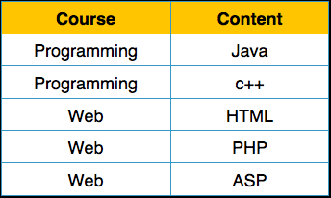
First Normal Form:
First Normal Form is defined in the definition of relations (tables) itself. This rule defines that all the attributes in a relation must have atomic domains. The values in an atomic domain are indivisible units.
We re-arrange the relation (table) as below, to convert it to First Normal Form

Slide 10
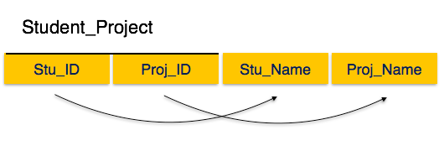
Second Normal Form
Before we learn about the second normal form, we need to understand the following −
Prime attribute − An attribute, which is a part of the candidate-key, is known as a prime attribute.
Non-prime attribute − An attribute, which is not a part of the prime-key, is said to be a non-prime attribute.
If we follow second normal form, then every non-prime attribute should be fully functionally dependent on prime key attribute. That is, if X → A holds, then there should not be any proper subset Y of X, for which Y → A also holds true.
In Student Project relation that the prime key attributes are Stu_ID and Proj_ID. According to the rule, non-key attributes, i.e. Stu_Name and Proj_Name must be dependent upon both and not on any of the prime key attribute individually. But we find that Stu_Name can be identified by Stu_ID and Proj_Name can be identified by Proj_ID independently. This is called partial dependency, which is not allowed in Second Normal Form.+

Slide 11
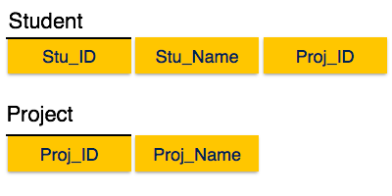
Third Normal Form
For a relation to be in Third Normal Form, it must be in Second Normal form and the following must satisfy −
No non-prime attribute is transitively dependent on prime key attribute.
For any non-trivial functional dependency, X → A, then either −
X is a superkey or,
A is prime attribute.

Slide 12
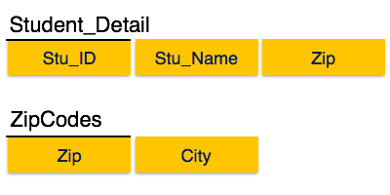
We find that in the above Student_detail relation, Stu_ID is the key and only prime key attribute. We find that City can be identified by Stu_ID as well as Zip itself. Neither Zip is a superkey nor is City a prime attribute. Additionally, Stu_ID → Zip → City, so there exists transitive dependency.
To bring this relation into third normal form, we break the relation into two relations as follows −

