Slide 1
Mr. Shaikh Amjad R.
Asst. Prof in Dept. of Computer Sci.
Mrs. K.S.K College Beed
Computer Fundamental Basics

Slide 2
Types of Computers
Supercomputers...are used to process very large amounts of information including processing information to predict hurricanes, satellite images and navigation, and process military war scenarios.
Mainframes...are used by government and businesses to process very large amounts of information.
Mini-Computers...are similar to mainframes...they are used by business and government to process large amounts of information.
Personal Computers (PC)…

Slide 3
Types of Computers
Personal Computers (Continued)
Personal Computers...also known as PC’s...are smaller and less powerful than the others. They are used in homes, schools, and small businesses.

Slide 4
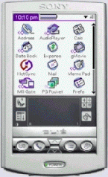
Types of Computers
There are 3 main types of PCs
Desktop
Portable (Notebook/Laptop)
When portable (notebook/laptop) computers were first created they were HUGE. They weighed around 100 lbs., and were carried in a large luggage suitcase. The creators of the portable (notebook/laptop) computer dreamed that one day it would be the size a notebook or pocket dictionary. With today’s technology, we have been able to accomplish this goal and more..
Hand-Held

Slide 5


Networks
A network is a group of computers that share information and hardware.
The computers are connected together using copper phone wires, fiber optic cables, or radio waves.
Our computers are on a network here at school...Look under the table and see the blue wires that connect your computer to the network.
The internet is many networks around the world that are all connected together to make 1 huge network.

Slide 6
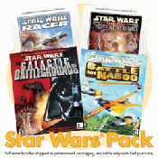
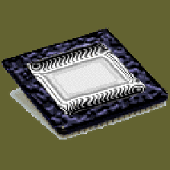
Parts of a Computer
There are two basic parts that make up a computer...
Hardware
Software

Slide 7
Hardware
Hardware is basically anything that you can touch with your fingers.
• Input Devices - Key board, Mouse..
• CPU - (Brain) Named on model: 80286, 80386, 80486, Pentium, P-II, Core 2 Duo..
• Output Devices - VDU/Screen, Printer
• Memory - RAM - Active, temporary ROM - Permanent.
• Ancillary Storage devices: Floppy, Hard Disk, CD ROM, Tapes etc.
• Scanner, Modem, Digital Camera, Video adopter, Computer Projector, Slide maker, etc.

Slide 8
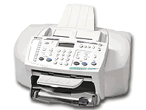
Hardware (Continued)
There are three types/categories of hardware
1. Input Devices
2. Output Devices
3. Storage Devices

Slide 9
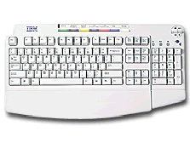
Input Devices
Input basically means getting data into the computer to be processed.
Keyboard, Mouse,
Trackball, Touch Pad
Light Pen, Laser Scanner,
Pointing Stick
Touch Screen,
Bar Code Reader, Scanner
Microphone, Joystick

Slide 10
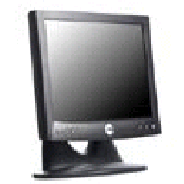
Output Devices
Output basically means getting data out of the computer.
Monitor
Printer
Speakers
Headphones
Modem
Fax

Slide 11
Storage Devices
Storage devices are both input and output devices in one. A storage device is a place to keep data that has been processed so that it can be retrieved at a later time to be used again.
Hard Disk
Floppy Disk
CD’s, DVD’s
Magnetic Tape
Flash Memory, Jump Drive

Slide 12
Software
Software is the programs and applications that tell the computer what to do and how to look.
Computer programmers write the codes/instructions that make-up software applications/programs.
HTML is a type of computer programming language that allows programmers to make web pages.
The next 2 slides show what HTML codes look like and the web page the codes produce.

Slide 13
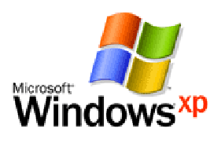
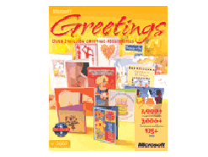
Two Types of Software
System Software
Application Software

Slide 14
Operating System Software
Directs all the activities and sets all the rules for how the hardware and software will work together.
Examples would be:
DOS, Windows 95, 98, ME, NT, XP, Vista, Windows 7
Unix, Linux,
MAC system OS 6,7,8,9,10

Slide 15
Command Line Operating Systems
DOS is an example of a command line operating system.
On the next slide, Notice that there are no:
Icons (pictures)
Colors
Mouse Pointer
Buttons
You have to memorize commands in order to use this text based operating system.

Slide 16
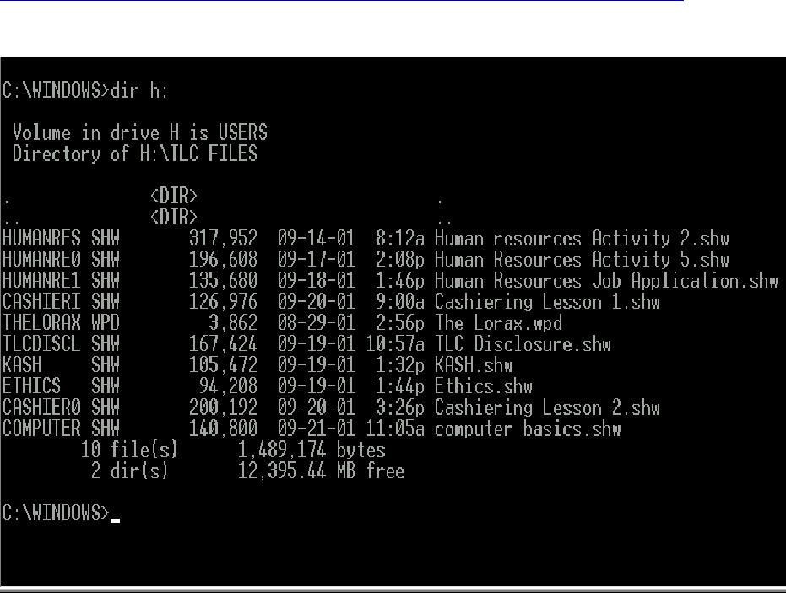

Slide 17
Operating Systems: GUI
GUI stands for Graphical User Interface
Uses pictures (icons) to represent files, folders, disk drives, modems, printers, etc.
GUI’s were created to make using a computer easier, more interesting, non-threatening to inexperienced users.
A mouse allows users to point at something and click to make it work. With command line you have to have all of the commands to make your programs work.
Here is an example of a GUI

Slide 18
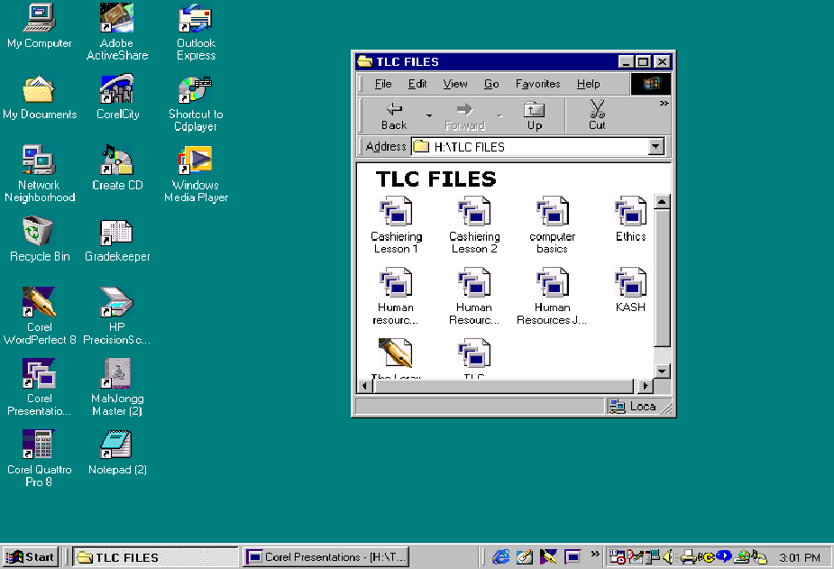

Slide 19
Application Software
Applications software comprises programs designed for an end user, such as word processors, database systems, and spreadsheet programs. Application software makes computer popular and easy to use. Common application software:
• Microsoft Word, WordPerfect
• PowerPoint
• Netscape, Internet Explorer
• Photoshop, Photo-Paint
• Quick Time
• Dreamweaver
Programs that work with operating system software to help the computer to do specific types of work.

Slide 20
Application Software
There are six basic types of application software...

Slide 21
Application Software
1. Business software: word processors, spreadsheets, and database programs.
2. Communication software: allows computers to communicate with other computers: fax software, Novell NetWare, AOL, Modem Software.
3. Graphics software: software that allows users to create and manipulate graphics...Photoshop, Print Shop, etc.

Slide 22
Application Software
4. Education and Reference software: Programs that help teach new material and ideas, and programs that can be used to find information...Encarta, Worldbook Encyclopedia, Jumpstart Kindergarten, MicroType.
5. Entertainment and Leisure software...Warcraft, Age of Empires, Barbie Design Center, Mrs. Pacman, Solitair
6. Integrated software: Combines several types of software into one program or package...Quicken (Spreadsheet/data base/communications/reference) or Print Shop (Graphics/Word processor).

