Slide 1
Carbohydrates
By
Dr.S.V. Lamture

Slide 2
The Aldotetroses. Glyceraldehyde is the simplest carbohydrate (C₃, aldotriose, 2,3-dihydroxypropanal). The next carbohydrate are aldotetroses (C₄, 2,3,4-trihydroxybutanal).

Slide 3
23.4: Aldopentoses and Aldohexoses.
Aldopentoses: C₅, three chiral carbons, eight stereoisomers
Aldohexoses: C₆, four chiral carbons, sixteen stereoisomers

Slide 4
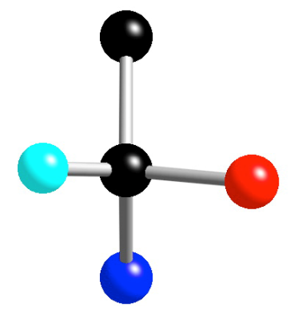
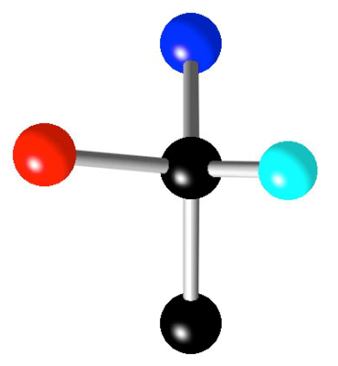
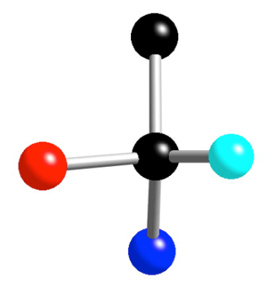
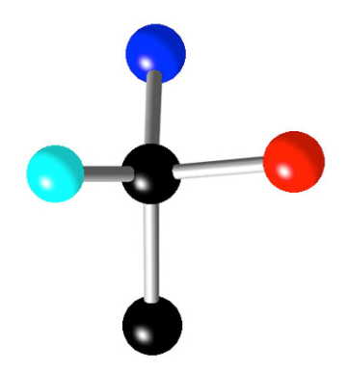
Manipulation of Fischer Projections
Fischer projections can be rotate by 180° (in the plane of the
page) only!
180°
180°
Valid
Fischer
projection
Valid
Fischer
projection

Slide 5
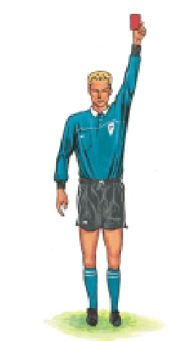
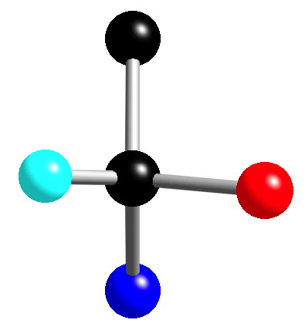
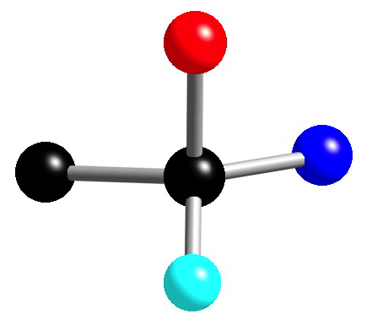
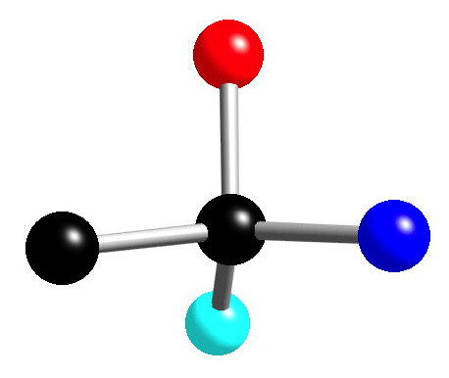
a 90° rotation inverts the stereochemistry and is illegal!
This is not the correct convention
for Fischer projections
90°
Should be projecting toward you
Should be projecting away you
This is the correct convention
for Fischer projections and is
the enantiomer

Slide 6
If one group of a Fischer projection is held steady, the other
three groups can be rotated clockwise or counterclockwise.
120°
120°
120°
120°

Slide 7
Thanks for your Attention

