Slide 1
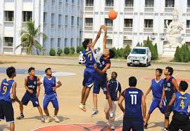
WEL COME
Dr. Udhave Kale
Department of PHYSICAL EDUCATION

Slide 2
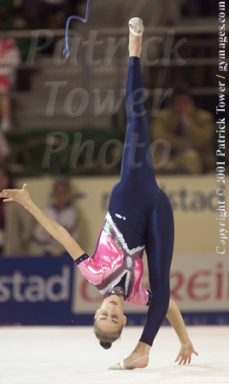
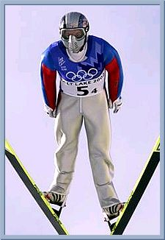
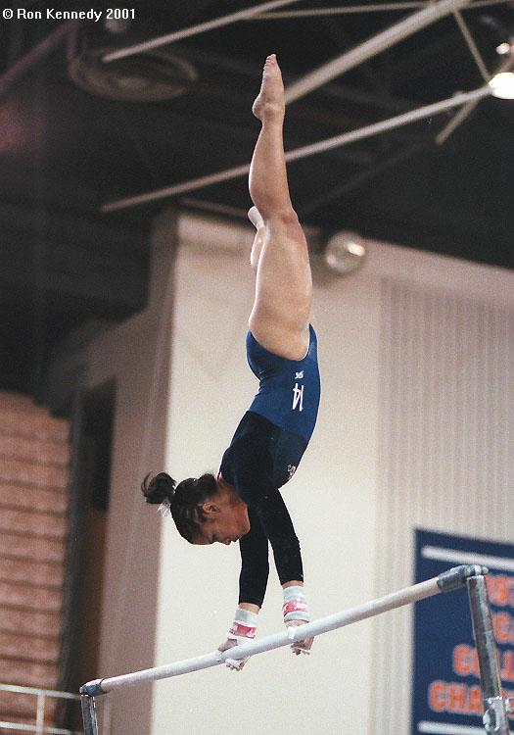
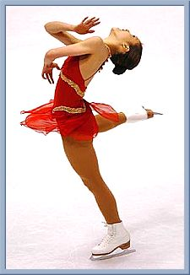
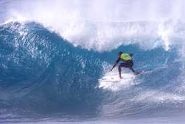
Balance
Balance is the ability to keep an upright posture while standing still or moving. People with good balance are most likely to be good in activities such as gymnastics, ice skating, rhythmic gymnastics, ski-jumping, surfing, etc.

Slide 3
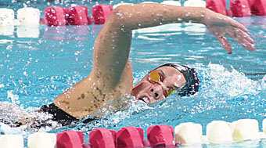
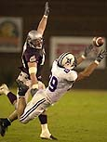
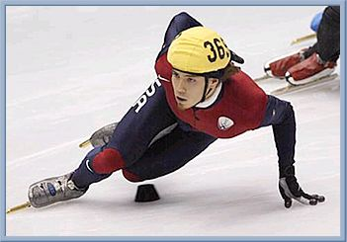
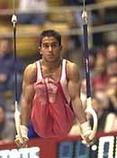
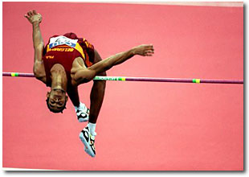
Power
Power is the ability to use strength and speed. People with good power might have the ability to put the shot, throw the discus, high jump, play football, speed swim, speed skate, etc.

Slide 4
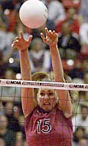
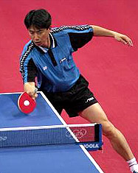
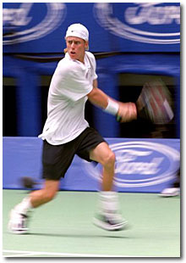
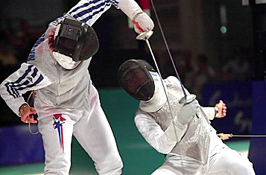
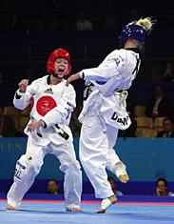
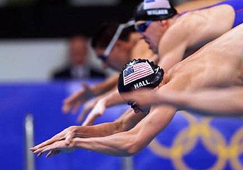
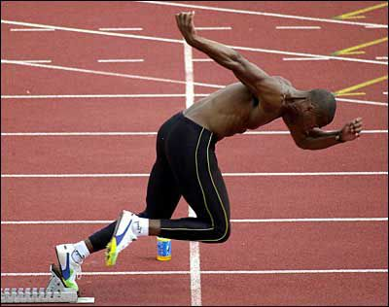
Reaction Time
Reaction time is the amount of time it takes to move once you realize the need to act. People with good reaction time are able to make fast starts in track or swimming, or to dodge a fast attack in fencing or karate.

Slide 5
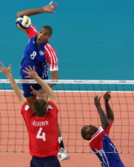
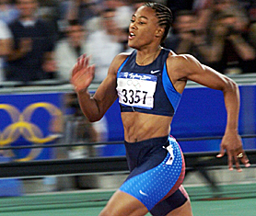
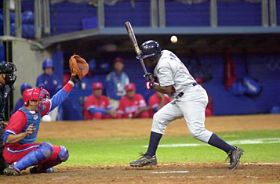
Speed
Speed is the ability to perform a movement or cover a distance in a short period of time. People with leg speed can run fast, while people with good arm speed can throw fast or hit a ball that is thrown fast.

Slide 6
Lifetime Fitness
Step 1: Doing Physical Activity
Step 2: Getting Fit
Step 3: Self-Assessment
Step 4: Self-Planning
Step 5: Lifetime Activity
Step 6: Lifetime Fitness

Slide 7
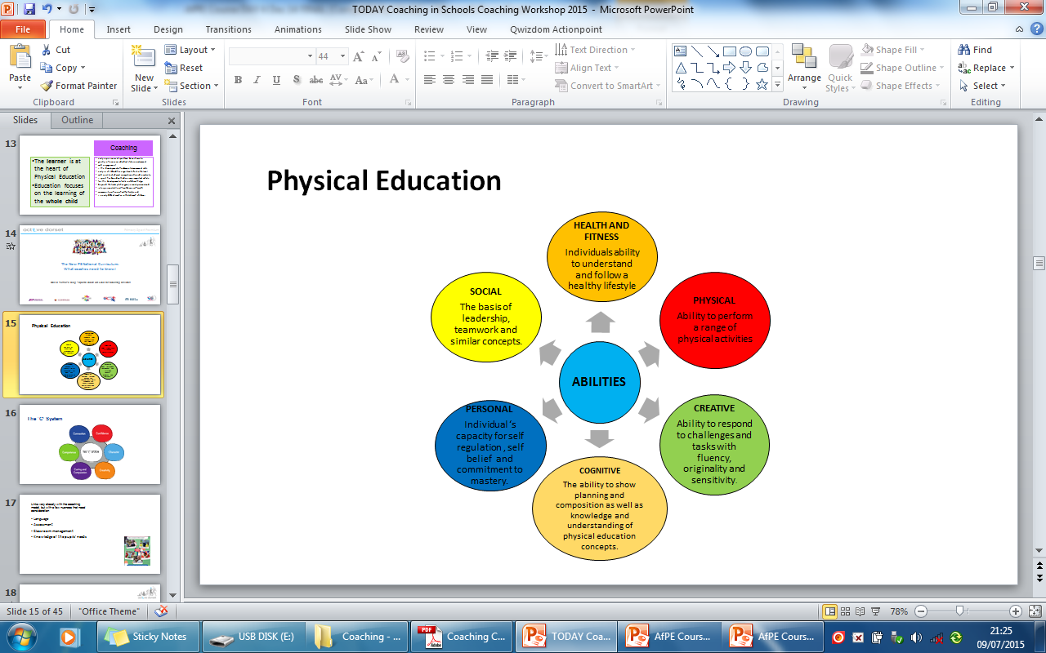
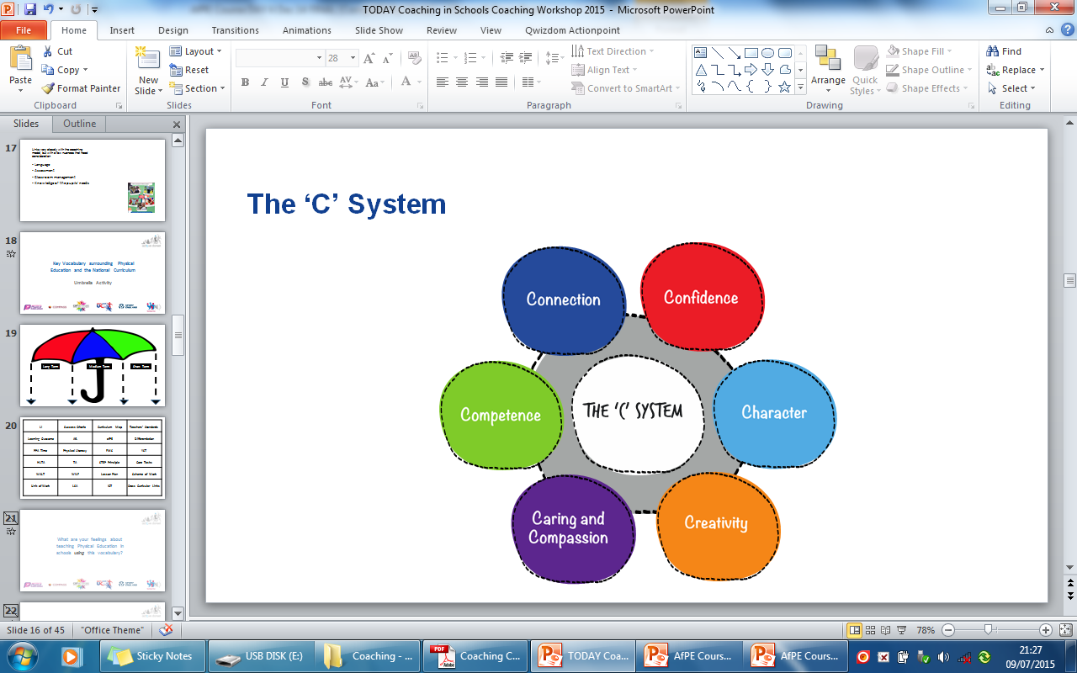
Physical Education
Coaching

Slide 8







Coaching in Schools – The Essential Knowledge
Physical Education
The learner is at the heart of PE
Education of the whole child
National Curriculum - core subject
Coaching in Schools – The Essential Knowledge

Slide 9
END

