Slide 1
The efficiency of public finance, the role of Government and the economic development in undeveloped areas
Song Bingtao
School of Economics, Henan University, China sbingtao@hotmail.com

Slide 2
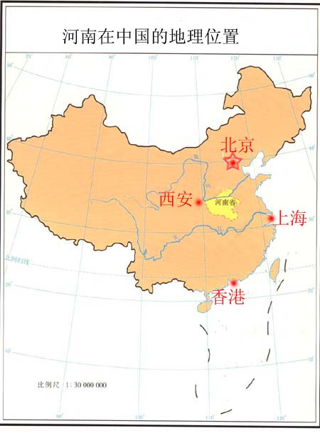

Slide 3
CONTENT
THE POVERTY OF DEVELOPMENT ECONOMICS
OVERLOOK ON BUPLC FINANCE
A NEW MODEL OF ECONOMIC DEVELOPMENT
THE EFFICIENCY OF PUBLIC FINANCE AND THE ROLE OF GOVERNMENTS IN SOME CASES

Slide 4
1. ECONOMIC DEVELOPMENT AND DEVELOPMENT ECONOMICS
Objective: transformation and economic development in undeveloped areas
History: once succeed in past as parts of classical economics
Judgment: unsuccessful in last 50years in interpretation of WE,NA and EA, and guideline for undeveloped and developing countries

Slide 5
Causes and conditions
The completion of transformation and the 1st stage of development in developed E, the topics of development disappeared in mainstream, they just focus on facts from developed countries
Lack of various kinds of successful cases
Complexity of topics, involved all area of people activities, need more help from other social sciences

Slide 6
New opportunity:
New cases: China, India, Russia
New development in other areas, such as game theory, public choice and economic history
New economists from developing countries who observe and experience the process of development

Slide 7
2. THE OVERLOOK OF DEVELOPMENT ECONOMICS ON THE EFFICIENCY OF PUBLIC FINANCE AND THE ROLE OF GOVERNMENT
No institutional factors or variables in the model of mainstream, so no concerning on institutions in development economics,
Not to say, concerning on the system of government

Slide 8
In 1950s,overlook the market system, stress on capital, and on governments, but in distribute capital and technology rather than in supplying public goods. So no institutional change of governments, no advantage of governments in efficiency, no labor division and specialization in private and public goods between market and governments
Maybe politician and elites don’t like it

Slide 9
In 1970s, governments failed, back to market,
But, still no efficiency of governments, no market economy’s efficiency
No institutional change of public finance, no efficiency of governments
The system of public finance is important, but be ignored.

Slide 10
In 1990s, public finance or relationship between market and governments has been discussed (Stiglitz, 1999) in development economics.
Popular of new institutional school
Uncorporate equilibrium of group game theory(Auman and Shelling)
Public budget system be still overlooked
How to establish or initiate a new institution

Slide 11
3. A NEW MODEL OF ECONOMIC DEVELOPMENT
Perfectly competitive markets are defined by two primary characteristics: (1) the goods being offered for sale are all the same, and (2) the buyers and sellers are so numerous that no single buyer or seller can influence the market price.

Slide 12
Problem of mainstream model:
the price is an exogenous variable in the function of economic growth, and a base on which economic entities make their decisions.
Information economics no use about information of prices, here, because consumers always change their ideas.

Slide 13
Outcome:
The efficiency of market economy missed:
The role of entrepreneur: Guess the price of goods, even in a perfect competitive market
The efficiency of public finance: Bargaining between taxpayers and governments for the price of public goods

Slide 14
Impacts:
The model in mainstream just concerns production, which rely on labor, capital, technology, then innovation, but no any business
Misunderstanding: capitalists’ or entrepreneurs’ market economy
This misleading no influence on USA, but impact on developing countries which lack of entrepreneurs and institutions.

Slide 15
What is market economy?
Distribute resources by market system?
Maximum of profit by mathematics?
If so, the planner will do it best (Barro & Sala-i-Martin,2004).
But who knows the information in calculation?
The advantage of market over plan: Run business and efficiency from the mechanism of prices
Need a institution to permit entrepreneurs to guess and bargain the price with consumers, and governments do it with taxpayers.

Slide 16
How to analyze the efficiency from the bargaining in those system?
A new model of economic development:
Yi=Ui-Ci
Ui=Pi(fi,di,1/qi,ni)*qi(li,ri,ti,ki)
Ci=Cmi(li,ri,1/tmi,ki)+Csi(1/g1,1/g2)+ Cci(li,ri,1/tci,ki)
Cs is transaction cost in governments

Slide 17
Ways of economic development:
Trade: entrepreneurs guess preferences of consumers, and raise the prices;
Technology of trade to reduce transaction cost: invention of money;
Institutional changes to reduce transaction cost: property right system;

Slide 18
Technology of production to reduce costs: machines and organizations;
Institutional changes in governments to reduce transaction cost: budget system;
Capital and resources to replace labor: no save of cost, but bring us more leisure time----the objective of economic development
All factors have been analyzed in past, but budget system.What is it? How to get it?

Slide 19
4．THE EFFICIENCY OF PUBLIC FINANCE AND THE ROLE OF GOVERNMENTS IN SOME CASES
Is a state or government a trouble maker (like it in SA)? Or is it a solution (like it in EA)？( Evans,1992)
No answer just like private company, but we cannot ignored it
The key points here are what kind of government it is, what it does as a government and how it does those works. ----Efficiency

Slide 20
Efficiency of governments
Come from the political structure or budget system
The change of structure is slow and difficult
East Asia rely on both of market and government----strange way
However, not to plan or distribute resources, but to supply public goods efficiently

Slide 21
Cases of comparison on supplying of PG
Ortiz, Carlos Humberto, An economic growth model showing government spending with reference to Colombia and learning-by-doing, Colombia Economic Journal, Vol.2, No.1, 2004, pp158-186.
Song, Bingtao, The Institutional Change of Public Finance and Modern Economic Development：An Interpretation of the Puzzle of England from the Efficiency of Public Finance,phD Thesis,2007

Slide 22
Make the distinction of market economy and public economy
Improve the efficiency of governments’ services (Wade, 1990.)
How to do it?

Slide 23
Three systems:
the system to enforce laws and contracts with sovereignty,
the system of making decisions and supervising the actions of governments by taxpayers,
the system of showing and coordinating the preference of taxpayers on public goods and negotiating between taxpayers and governments

Slide 24
The hardness of economic development
We can not copy a system, they are a consequence of political struggle or cooperate game.
The system change will be influenced heavily by culture, history and old system.
Mass democracy is not a good way, the important point is taxpayer participating in the system. keep small group for cost and equilibrium(Olson,1980)

Slide 25
Thank you!

