Slide 1
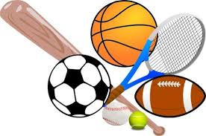
WEL COME
Dr. Udhav kale
Department of PHYSICAL EDUCATION

Slide 2
The organisation of sport in the USA
The organisation in America is decentralised and it is organised by many governing bodies.
Professional sport is prominent with much support from the public and companies.
A great deal of sponsorship from companies and media – the private sector is very important.

Slide 3
Federal Government
Department
of Education
Department of
Fish and Game
Parks and
Recreation
Commission
National Olympic Committee
National
Federation
of SHSAA
Governing Bodies
of the Different
Sports
Regional
Associations of the
Different Sports
Regional Conferences
High School
Athletic
Associations
College
Athletic
Associations
Local
subdivisions

Slide 4
The historical development of sport
Following the pattern in Europe, American schools ignored the physical side of pupil welfare.
The curriculum was strictly classical, and not until the 19th century did physical exercise, usually Gymnastics, come to be considered an important aspect of Education.
Round Hill School, Massachusetts, was an early example of adopting a ‘European School’ approach to physical education, with particular respect for German gymnastics.
Boys were taught to ride, skate and swim in addition to baseball and football.

Slide 5
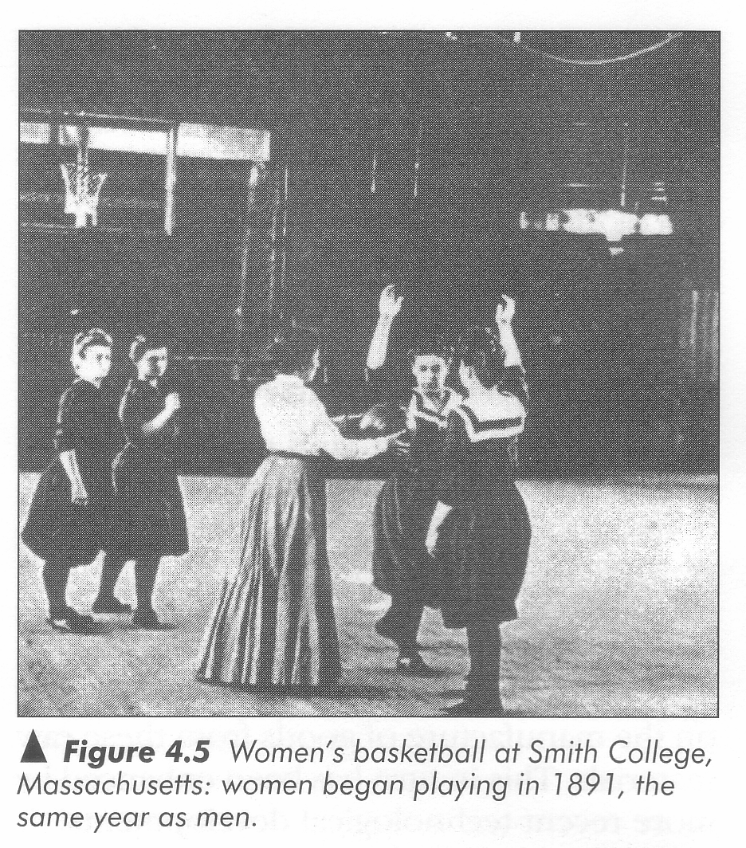
Girls started to play basketball and football.
As in Europe, there was opposition from individuals who held conventional ideas.
Basketball for girls at College Smith, Massachusetts:
girls started playing in 1981, the same year as men.

Slide 6
Sport in high schools
These trends still exist today, where sport is considered more important than physical education.
More provision, money and staffing are offered.
Many games are played in front of large audiences.
This brings much money to the school.

Slide 7
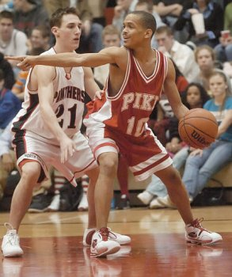
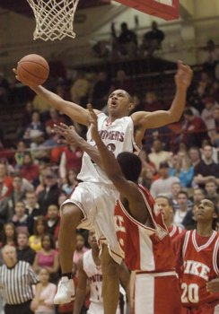

Slide 8
A simplified structure of sport and physical education in American schools
State sport body
College head
Director of athletics
Head of coaching Head of
physical education
Coaching staff Physical
education staff
Student body
College teams ‘Varsity teams’ Physical Education Programme

Slide 9
The strain put on coaches
coach
Director
of athletics
Department
and students
media
supporters
Administrative
staff
Fellow coaches
The school’s
administrative
work
State and
national
athletic union
parents
players

Slide 10
END

