Slide 1
Dr. Hange A.S. International Economics
Trade, The Balance of Payments and Exchange Rates

Slide 2
Trade
Buying and selling goods and services from other countries
The purchase of goods and services from abroad that leads to an outflow of currency from the UK – Imports (M)
The sale of goods and services to buyers from other countries leading to an inflow of currency to the UK – Exports (X)

Slide 3
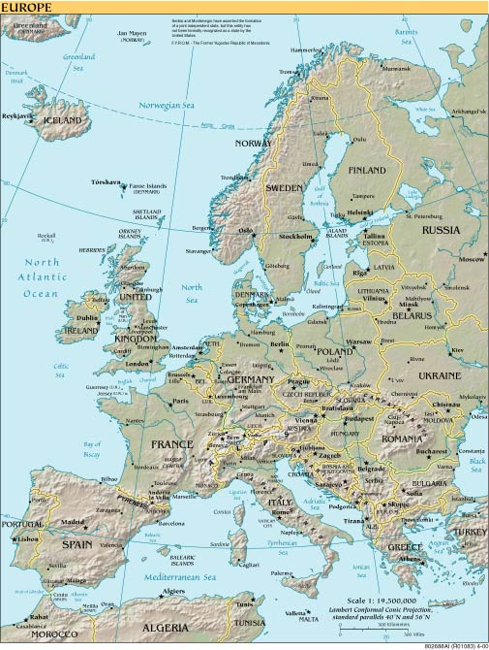
The Flow of Currencies:
Whisky sold to Italian hotel
Export earnings for UK
(Credit on Balance
of Payments)
€ changed to £
Map courtesy of http://www.theodora.com

Slide 4
The Flow of Currencies:
Oil from Russia
Oil
£ changed into Roubles
Export earnings for Russia
Import expenditure for the UK
(Debit on balance of payments)
Map courtesy of http://www.theodora.com

Slide 5
Specialisation and Trade
Different factor endowments mean some countries can produce goods and services more efficiently than others – specialisation is therefore possible:
Absolute Advantage:
Where one country can produce goods with fewer resources than another
Comparative Advantage:
Where one country can produce goods at a lower opportunity cost – it sacrifices less resources in production

Slide 6
Comparative Advantage
 | Oil (Barrels) | Whisky (Litres)
Russia | 10 or | 5
Scotland | 20 or | 40
One unit of labour in each country can produce either oil OR whisky.
A unit of labour in Russia can produce either 10 barrels of oil per period OR 5 litres of whisky.
A unit of labour in Scotland can produce either 20 barrels of oil OR 40 litres of whisky.

Slide 7
Comparative Advantage
Opportunity Cost = sacrifice/ gain
Russia: if it moved 1 unit of labour from whisky to oil it would sacrifice 5 litres of whisky but gain 10 barrels of oil (OC = 5/10 = ½)
Moving 1 unit of labour from oil to whisky production would lead to a sacrifice of 10 barrels of oil to gain 5 litres of whisky (OC of whisky is 10/5 = 2)
Scotland: if it moved 1 unit of labour from whisky to oil it would sacrifice 40 litres of whisky but gain 20 barrels of oil (OC = 40/20 = 2)
Moving 1 unit of labour from oil to whisky production would lead to a sacrifice of 20 barrels of oil to gain 40 litres of whisky (OC of whisky is 20/40 = ½ )
For Scotland the OC of oil is four times higher than that in Russia
(2 compared to ½)

Slide 8
Comparative Advantage
In Russia, oil can be produced cheaper than in Scotland (Russia only sacrifices 1 litre of whisky to produce 2 extra barrels of oil whereas Scotland would have to sacrifice 2 litres of whisky to produce 1 barrel of oil.
There can be gains from trade if each country specialises in the production of the product in which it has the lower opportunity cost – Russia should produce oil; Scotland, whisky.

Slide 9
Comparative Advantage
Before trade – each country divides its labour between the two products:
 | Oil (Barrels) | Whisky (Litres)
Russia | 5 | 2.5
Scotland | 10 | 20
Total Output | 15 | 22.5
After specialisation – each country devotes its resources to that in which it has
a comparative advantage.
 | Oil (Barrels) | Whisky (Litres)
Russia | 10 | 0
Scotland | 0 | 40
Total Output | 10 | 40

Slide 10
Comparative Advantage
Total Output has risen and trade can be arranged at a mutually agreed rate that will leave both countries better off than without trade. The rate has to be somewhere between the OC ratios (in this case 2 and ½)
e.g. If the trade were arranged at 1 barrel of oil for 1 litre of whisky the end result would be:

Slide 11
Comparative Advantage
Before Trade:
 | Oil (Barrels) | Whisky (Litres)
Russia | 5 | 2.5
Scotland | 10 | 20
Total Output | 15 | 22.5
After Trade:
 | Oil (Barrels) | Whisky (Litres)
Russia | 5 | 10
Scotland | 5 | 30
Total Output | 10 | 40

Slide 12
The Terms of Trade
The Terms of Trade looks at the relationship between the price received for exports and the amount of imports we are able to buy with that money.
Average Price of Exports
Terms of Trade = ----------------------------------------
Average Price of Imports

Slide 13
The Balance of Payments
A record of the trade between the UK and the rest of the world.
Trade in goods
Trade in services
Income flows
= Current Account
Transfer of funds and sale of assets and liabilities
= Capital Account

Slide 14
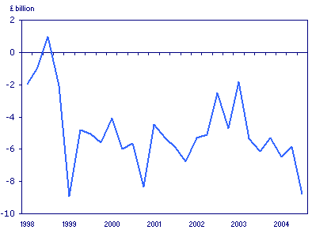
Balance of Payments
The UK Balance of Payments on Current Account 1998 - 2004
Source: ONS (http://www.statistics.gov.uk/cci/nugget.asp?id=194) (Crown copyright material is reproduced with the permission of the Controller of HMSO and the Queen's Printer for Scotland.)

Slide 15
Exchange Rates
The rate at which one currency can be exchanged for another e.g.
£1 = $1.90
£1 = €1.50
Important in trade

Slide 16
Exchange Rates
Converting currencies:
To convert £ into (e.g.) $
Multiply the sterling amount by the $ rate
To convert $ into £ - divide by the $ rate: e.g.
To convert £5.70 to $ at a rate of £1 = $1.90, multiply 5.70 x 1.90 = $10.83
To convert $3.45 to £ at the same rate, divide 3.45 by 1.90 = £1.82

Slide 17
Exchange Rates
Determinants of Exchange Rates:
Exchange rates are determined by the demand for and the supply of currencies on the foreign exchange market
The demand and supply of currencies is in turn determined by:

Slide 18
Exchange Rates
Relative interest rates
The demand for imports (D£)
The demand for exports (S£)
Investment opportunities
Speculative sentiments
Global trading patterns
Changes in relative inflation rates

Slide 19
Exchange Rates
Appreciation of the exchange rate:
A rise in the value of £ in relation to other currencies – each £ buys more of the other currency e.g.
£1 = $1.85 £1 = $1.91
UK exports appear to be more expensive ( Xp)
Imports to the UK appear to be cheaper ( Mp)

Slide 20
Exchange Rates
Depreciation of the Exchange Rate
A fall in the value of the £ in relation to other currencies - each £ buys less of the foreign currency e.g.
£1 = € 1.50 £1 = € 1.45
UK exports appear to be cheaper
( Xp)
Imports to the UK appear more expensive ( Mp)

Slide 21
Exchange Rates
A depreciation in exchange rate should lead to a rise in D for exports, a fall in demand for imports – the balance of payments should ‘improve’
An appreciation of the exchange rate should lead to a fall in demand for exports and a rise in demand for imports – the balance of payments should get ‘worse’ BUT

Slide 22
Exchange Rates
The volumes and the actual amount of income and expenditure will depend on the relative price elasticity of demand for imports and exports.

Slide 23
Exchange Rates
$ per £
S£
The rise in demand creates a shortage in the relationship between demand for £ and supply – the price (exchange rate) would rise
Investing in the UK would now be more attractive and demand for £ would rise
Assume an initial exchange rate of £1 = $1.85. There are rumours that the UK is going to increase interest rates
1.90
1.85
D£₁
Shortage
D£
Quantity on
ForEx Markets
Q1
Q3
Q2

Slide 24
Exchange Rates
Floating Exchange Rates:
Price determined only by demand and supply of the currency – no government intervention
Fixed Exchange Rates:
The value of a currency fixed in relation to an anchor currency – not allowed to fluctuate
Dirty Floating or Managed Exchange Rate:
– rate influenced by government via central bank around a preferred rate

Slide 25
Exchange Rates
Purchasing Power Parity (PPP)
The relationship between the exchange rate and the price level in different countries.
The price of £ in the foreign currency = Foreign Country price level/UK price level

Slide 26
Exchange Rates
The exchange rate would be a proper reflection of the purchasing power in each country if the relative values bought the same amount of goods in each country.
E.g. If the price of a pint of Stella in the UK was £3.00 and in Europe €4.50, the exchange rate between the two countries should be £1 = €1.50
If any lower than this value, the £ would be undervalued and if any higher, the £ would be overvalued.

