Slide 1
Mrs.K.S.K.College,Beed Dept.of Zoology Topic LIFE CYCLE OF ENTAMOEBA HISTOLYTICA
DR.A.N.SHELKE

Slide 2
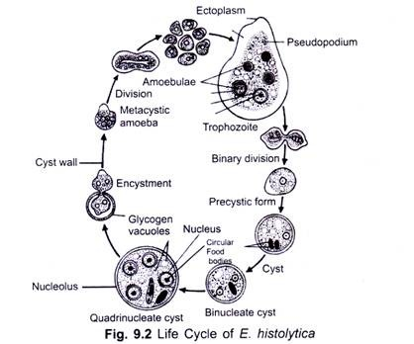
LIFE CYLCE OF ENTAMOEBA HISTOLYTICA

Slide 3
Life cycle
Entamoeba histolytica is monogenetic, i.e., its life cycle is completed on one host only; the man.
Its life cycle is completed as follows:
Encystment:
In the precystic forms, entamoeba remains only in the intestinal lumen. They undergo encystment but before encystment, the parasites round up, eliminate food vacuoles and accumulate considerable amount of food materials in the form of glycogen and black rod-like chromatoid granules. Each parasite secretes a thin, rounded, resistant, colourless and transparent cyst wall around it.
The cysts of Entamoeba histolytica vary in size. Its cytoplasm is clear and each cyst is mononucleate at this stage. Presence of chromatoid bodies is the characteristic of the cysts of Entamoeba histolytica. They occur either singly or in the multiples of two or more. The nucleus of the cysts divides twice so that each cyst now becomes tetra nucleate (fig. 9.2). At this stage, the cyst is infective to a new host. Encysted forms pass out with the faecal matter of the host

Slide 4
Transfer to new host:
The infective cysts remain viable for a considerable length of time outside the human intestine, if environmental conditions are favourable. Infection of fresh human host takes place by swallowing the infective cysts with contaminated food and drinks

Slide 5
Excystment
The metacystic trophozites feed on the contents of the intestine and grow in size to form the trophozites of the next generation. The trophozoites stay in the lumen of the intestine for a particular period when they may attack the wall of the intestine and start the life cycle again. Entamoeba histolytica causes amoebic dysentery, abscesses in liver, lungs and brain and non-dysenteric infections.

Slide 6
CONTROL MEASURES OF E.HISTOLYTICA
1. Sanitary disposal of faecal matter
2. Perfect sanitation and protection of water and vegetables from pollution.
3. Washing of hands with antiseptic soap and water before touching the food.
4. Cleanliness in preparing the food.
5. Protection of foods and drinks from houseflies, cockroaches, etc.
6. Raw and improperly washed and cooked vegetables should be avoided.

Slide 7
THANKS

