Slide 1
Wel Come
Dr.s.v. lamture
Asso. Prof.
Department of Chemistry

Slide 2
H-NMR
Nuclear Magnetic Resonance

Slide 3
NMR
Nuclear magnetic resonance relies on the magnetic field produced by a spinning nucleus containing an odd number of nucleons (protons or neutrons). In the presence of an external magnetic field the nucleus can exhibit more than one spin state and can move between these states by the absorption of electromagnetic radiation of a specific frequency (energy).
The energy absorbed can be detected and from this information about the location (environment) of the nucleus can be deduced.

Slide 5
NMR is probably the most useful tool in the organic chemists arsenal for structural determination.
As organisms are mainly water (containing H atoms with an odd number of nucleons), NMR has developed into an invaluable medical diagnostics tool, called an MRI (magnetic resonance instrument) scan.

Slide 6
Nuclear magnetic resonance
This tells us the number of hydrogen atoms in different environments within the molecule. As hydrogen is present in (almost) all organic compounds this technique is very useful. The pattern produced by the hydrogen atoms is often split into finer structure, that also gives information about the number of hydrogen adjacent to the absorbing atoms.

Slide 7
Nuclear energy levels
Nuclei with odd numbers of nucleons (protons and neutrons) can have different energy levels. To help us differentiate these energy levels we say that they have 'spin'.
A hydrogen nucleus can have two different 'spin' states. These are designated as spin = +1/2 and spin = -1/2.
For a hydrogen nucleus to change spin states it must absorb energy (promotion) or lose energy (relaxation).
Animation

Slide 8
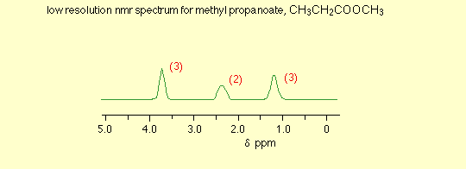
Low resolution NMR
A low resolution spectrum looks much simpler because it can't distinguish between the individual peaks in the various groups of peaks
The numbers against the peaks represent the relative areas under each peak. That information is extremely important in interpreting the spectra

Slide 9
The End

