Slide 1
Furan
By
Dr.S.V. Lamture
Asso. Prof. &Head
Dept of chemistry

Slide 2
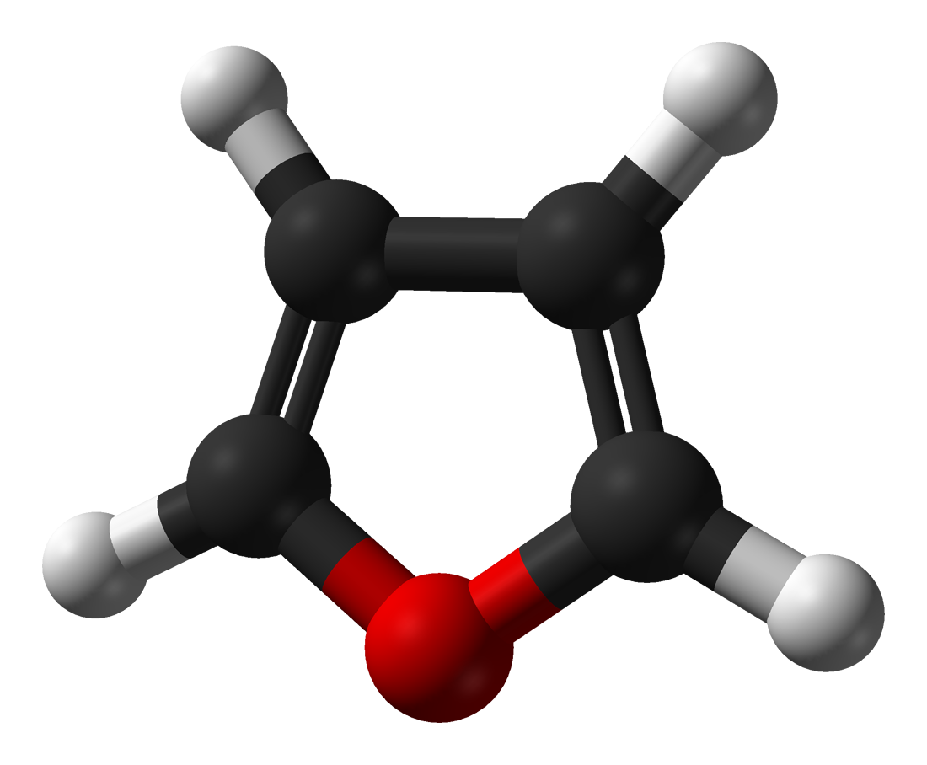
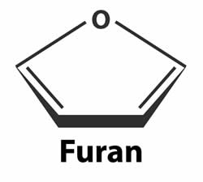
Furan (C₄H₄O)
Furan is a heterocyclic organic compound, consisting of a five-membered aromatic ring with four carbon atoms and one oxygen.
The class of compounds containing such rings are also referred to as furans.
Structurer Fig. Of Furan

Slide 3
Preparation of Furan
Industrially, furan is manufactured by the palladium-catalyzed decarboxylation of furfural, or by the copper-catalyzed oxidation of 1,3-butadiene.
In the laboratory, furan can be obtained from furfural by oxidation to furan-2-carboxylic acid, followed by decarboxylation.
It can also be prepared directly by thermal decomposition of pentose-containing materials, cellulosic solids especially pine-wood.

Slide 4
Properties of Furan
Furan is a colourless volatile liquid.
It’s boiling point is 31.4°C and melting point −85.6 °C.
Furan having odor of chloroform.
It is insoluble in ether but soluble in most organic solvents.
Uses of Furan
Furan is used as a starting point to other specialty chemicals.

Slide 5
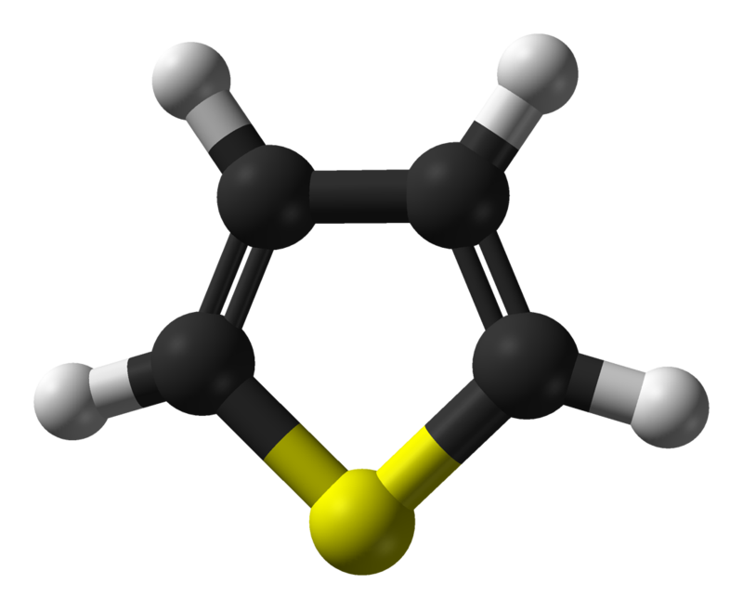
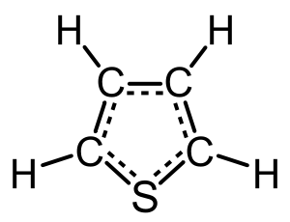
Thiophene (C₄H₄S)
Thiophene, also commonly called thiofuran, is a heterocyclic compound with the formula C4H4S.
Consisting of a flat five-membered ring, it is aromatic as indicated by its extensive substitution reactions.
Structurer fig. of Thiophene
Thiophene

Slide 6
Properties Of Thiophene
At room temperature, thiophene is a colorless liquid with a mildly pleasant odor reminiscent of benzene.
It’s boiling point is 84°C and melting point -38°C.
It is insoluble in water but freely soluble in ethanol, ether and acetone.
The high reactivity of thiophene toward sulfonation is the basis for the separation of thiophene from benzene.
Thiophene is much more reactive than benzene , thus thiophene undergoes the electrophilic substitution reactions like benzene , under moderate condition.

Slide 7
Uses of Thiophene
Thiophenes are important heterocyclic compounds that are widely used as building blocks in many agrochemicals and pharmaceuticals.
The benzene ring of a biologically active compound may often be replaced by a thiophene without loss of activity.
This is seen in examples such as the NSAID lornoxicam, the thiophene analog of piroxicam.

Slide 8
Thanks

